Slide 1
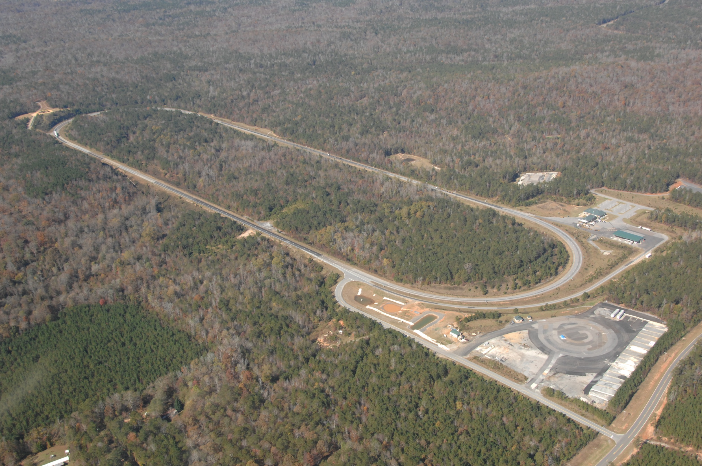
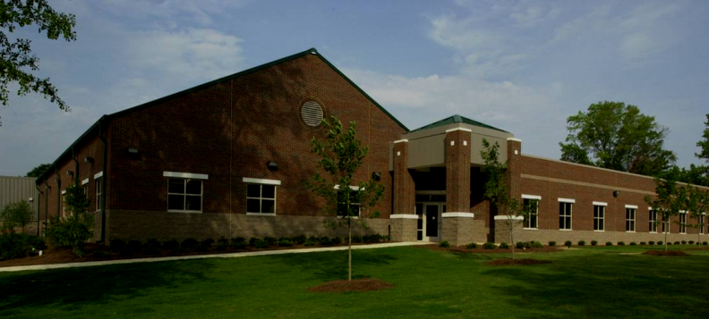
Planning for the 2012
Research Cycle
National Center for Asphalt Technology

Slide 2
Timeline
Project(s) request to ALDOT in summer 2011
Finish traffic by October 2011
  Track conference February 2012
Funding in place on March 1, 2012
Reconstruction Spring-Summer 2012
  Pavement preservation alternatives
  Alternative binders (e.g., ground tire rubber)
  Drainable surface durability (tack, raveling, joints)
  High recycled content pavements
Begin fleet operations August 2012

Slide 3
Traffic Continuation
N3 or N4 - by ALDOT for perpetual pavement
N6 - by Shell for longer performance analysis
N7 – by Kraton for longer performance analysis
N8 – by Oklahoma for high polymer rehabilitation
N11 – by EGGE for longer term high RAP warm mix
N13 – by Dynatest or FHWA for longer term noise reduction
W5 – by FHWA/APAC for longer term high RAP surface mix
W6 – by preservation group for longer term 4.75 mm
S2 – by Mississippi for longer term high RAP
S7 – by Missouri for more traffic on GTR
S12 – by TLA for longer term structural performance
E5 – by FHWA/APAC for longer term high RAP

Slide 4
Mill / Inlay
N1 and N2 – by Florida for spray paver versus thick trackless
N3 or N4 – by ALDOT for perpetual pavement surface rehab
N5 – by Shell to address sulfur mix RAP management concerns
N9 – by Oklahoma for surface crack mitigation in perpetual pvmt
N12 – by Georgia for micromilling on SMA for thin PFC surface
S1 – by preservation group for new 4.75 mm ¾” screenings mix
S5 – by Cargill for more epoxy friction surfaces
S6 – by Missouri for dry process GTR
Note that Virginia will also need space somewhere on tangents

Slide 5
Rejuvination
W10 – by preservation group for old raveled Superpave
S3 – by Mississippi to address raveling in gravel OGFC
S4 – by Tennessee to address raveling in limestone OGFC
S8 – by preservation group to address raveling in low RAP OGFC

Slide 6
Preservation
W10 – by preservation group with slurry seal for life extension
S9 – by preservation group with thin 4.75 mm inlay
S10 – by preservation group with microsurfacing
S11 – by preservation group with chip seal(s)
S12 – by preservation group with cape seal(s)
Note opportunity for many low cost 4.75 mm screenings mixes in the curves with sulfur, high fine RAP, etc.

Slide 7
Pavement Preservation
Lower cost 4.75 mm ¾” screenings mixes
Life cycle performance comparison study
  Thin overlays (virgin, high fine RAP, sulfur, etc.)
  Microsurfacing
  Chip seal(s)
  Cape seal
Scrub/slurry seals on badly raveled surfaces

Slide 8
Structural Sections
N1 and N2 – by EGGE group for more green sections
N3 or N4 – by EGGE group for Superpave WMA 30% RAP control
N5 – by EGGE group for SMA over high mod binder over rich base
N10 – by EGGE group for California rubber with PFC surface
N12 and N13 – new structural by EGGE group for more sections
S6 and S7 – new structural by EGGE group for more sections
S12 – by Lake Asphalt for TLA/WMA/RAP package

Slide 9
EGGE Section Possibilities
Superpave WMA 30% RAP control
SMA over high mod binder over rich base
California rubber with PFC surface
Various types of In-place recycling
SMA with iBind over high mod binder over rich base
High RAP with both sulfur and TLA but zero virgin refined asphalt

