Slide 1
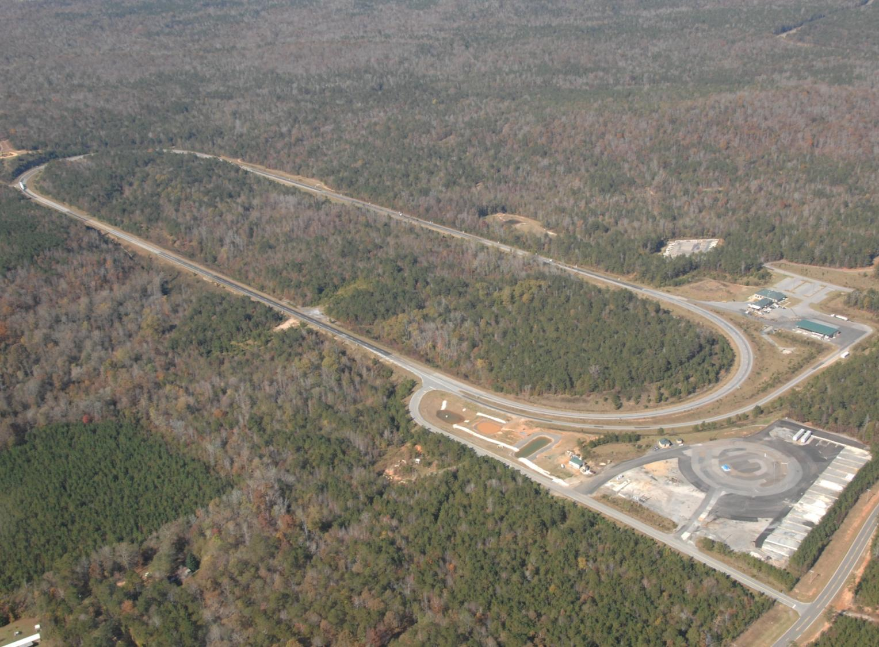

Preliminary Lab to Field
Performance Comparisons
National Center for Asphalt Technology

Slide 2
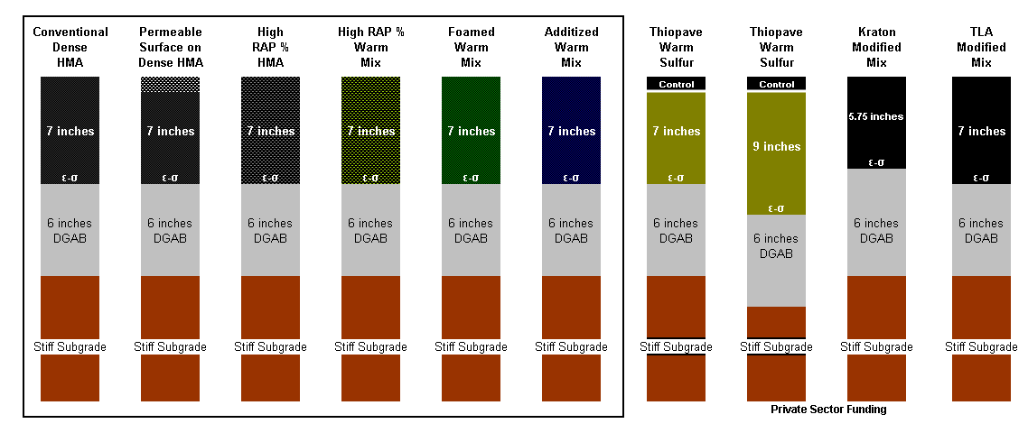
2009 Group Experiment (+)

Slide 3
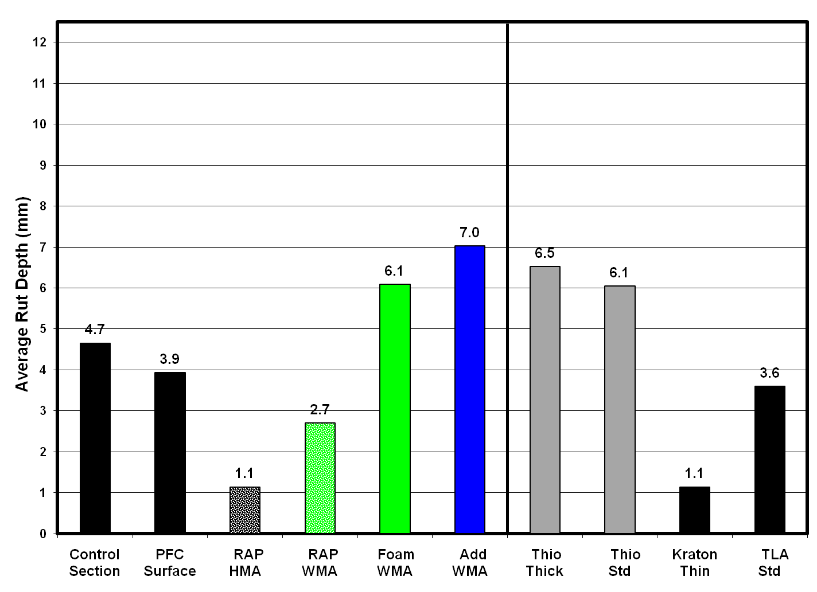
2009 Group Experiment (+)

Slide 4
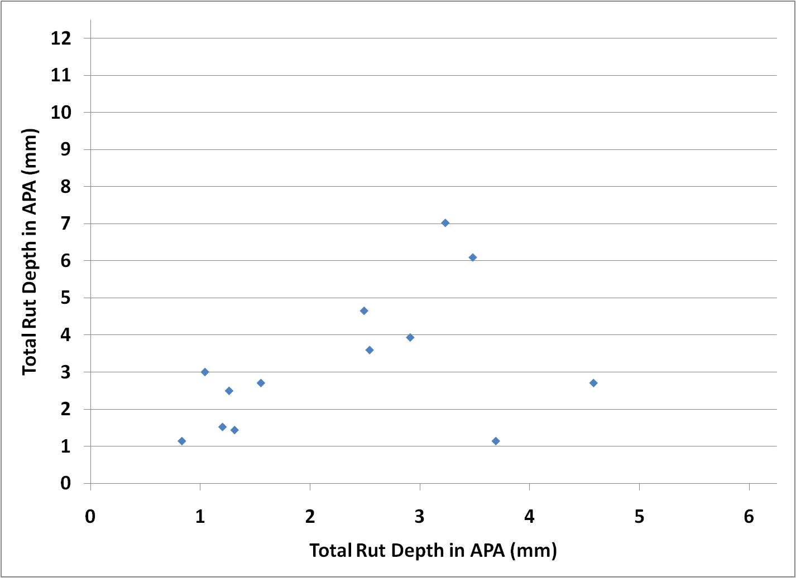
APA – Total Rut Depth

Slide 5
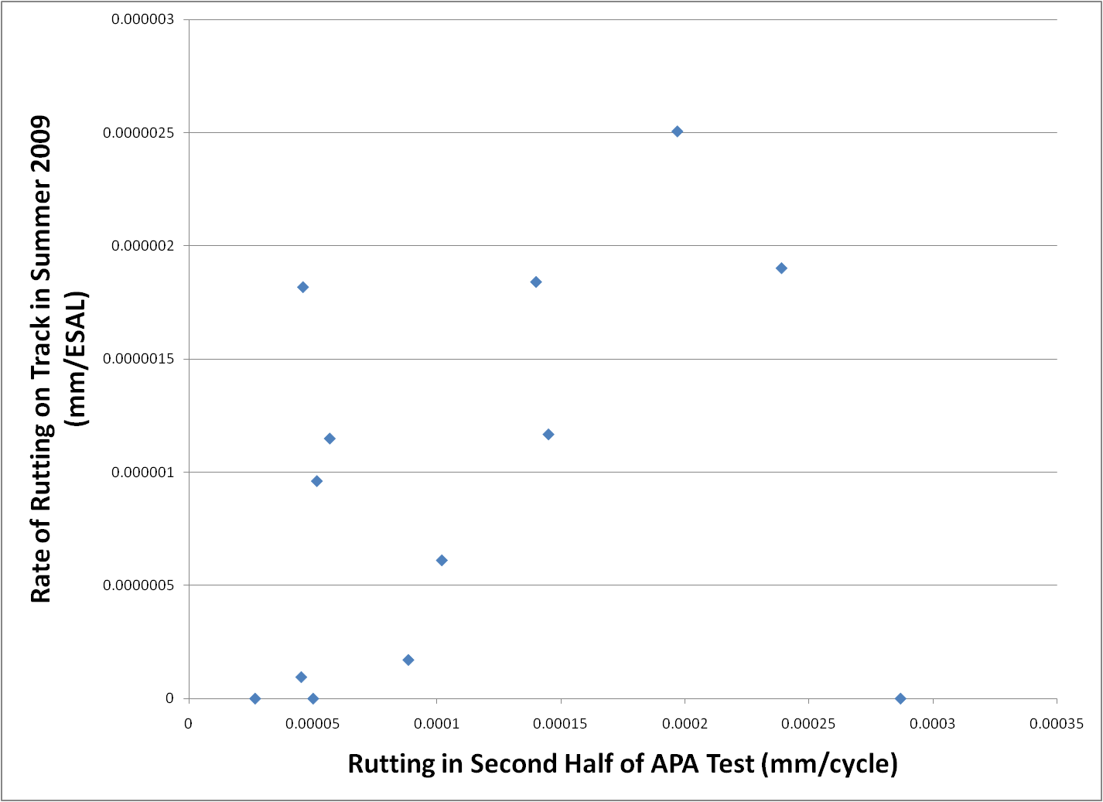
APA – Rate of Rutting

Slide 6
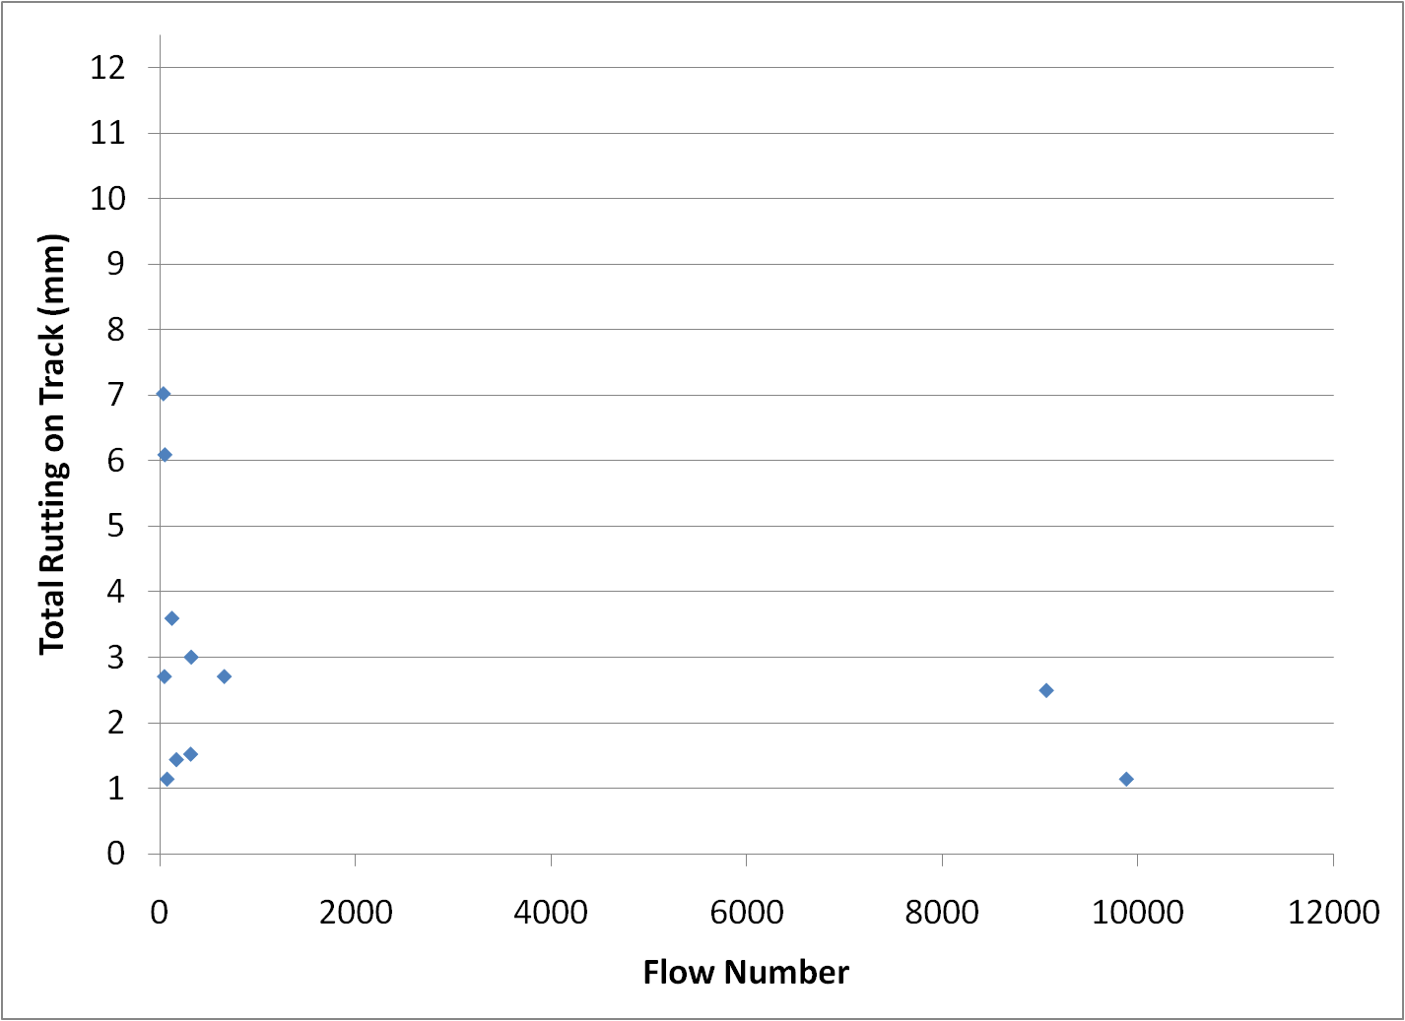
Flow Number

Slide 7
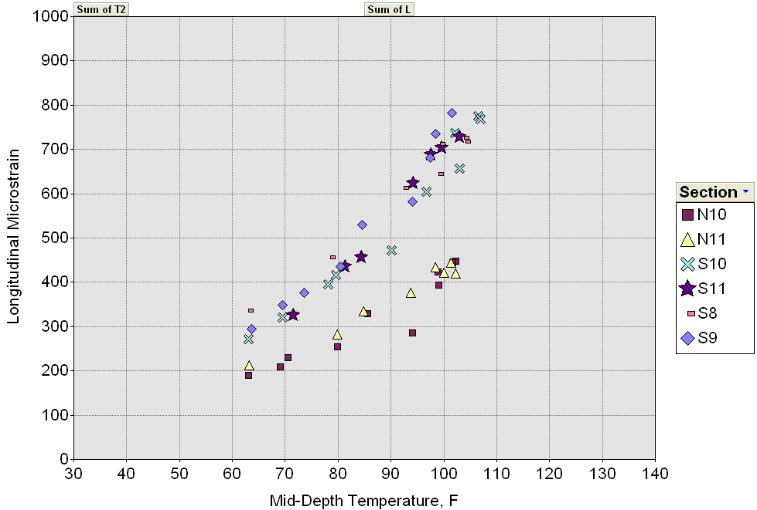
GE Strain Response
Virgin Mixes
50% RAP

Slide 8
GE Strain Response
Virgin Mixes
50% RAP

Slide 9
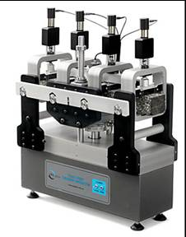
GE Strain Response
Virgin Mixes
50% RAP

Slide 10
2006 Recycled Mix Performance

Slide 11
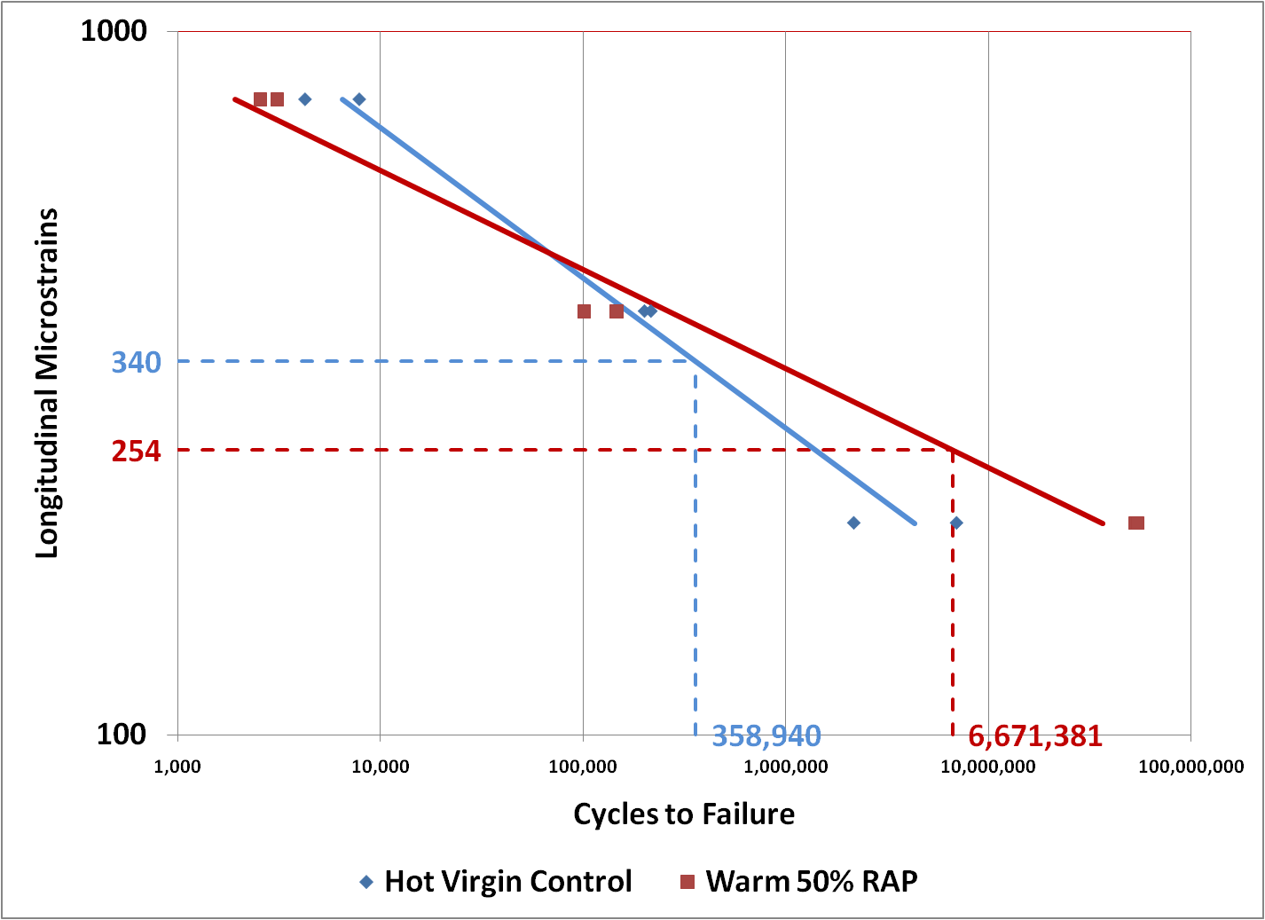
Beam Fatigue Results

Slide 12
Beam Fatigue Results

Slide 13
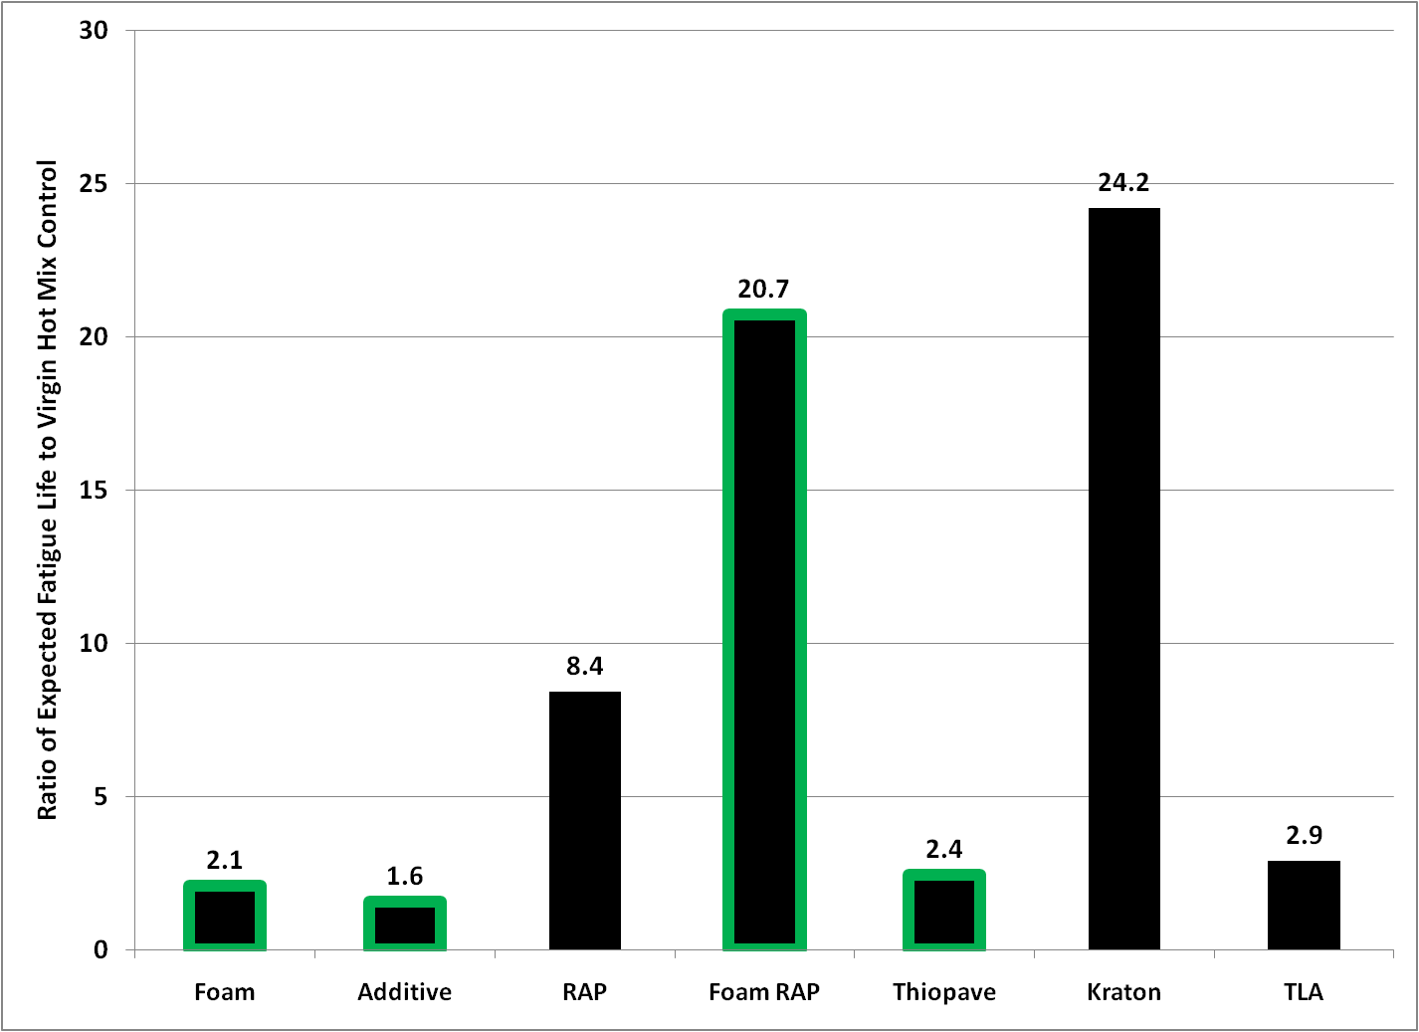
Fatigue Projections

Slide 14
Questions ?

