Slide 1
Use of Ground Tire Rubber Modified Binder
Nam Tran
Lead Research Engineer

Slide 2
Overview
Methods of incorporating GTR
Applications of rubber-modified binders
Performance of test sections at NCAT test track
Questions and concerns

Slide 3
Methods

Slide 4
Methods
Two methods for incorporating GTR into HMA
Wet process
GTR acts as a binder modifier (up to 20% of total binder)
2 processes: asphalt-rubber and terminal blend
Dry process
GTR acts as a rubber aggregate (1-3% of aggregate)

Slide 5
Asphalt-Rubber
> 15% crumb rubber passing #8 or #10 mesh
Reacted sufficiently to cause swelling of rubber
2 types of asphalt-rubber binders
Type I (used in AZ and TX) 18-20% crumb rubber
Type II (used in CA) about 20% rubber
75% tire rubber and 25% natural rubber
May include up to 6% heavy aromatic oils
Both types blended at elevated temp (>350ºF) in low shear system for at least 45 minutes

Slide 6
Terminal Blend
5-20% crumb rubber passing #40 or #80 mesh
Blended in refinery or stationary asphalt terminal with little or no agitation
Can contain polymers
All components heated over extended period of time to dissolve rubber particles
Used in Arizona, California, Florida, Texas, and several northeastern states

Slide 7
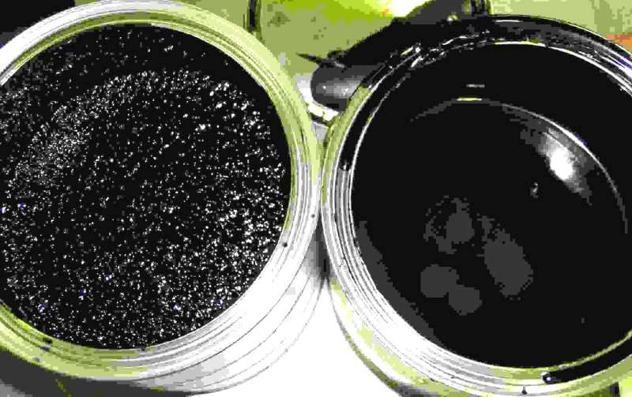
Asphalt Rubber vs. Terminal Blend
Asphalt Rubber
Rubberized Asphalt Terminal Blend
1,500-2,500 centipoises at 375°F, extremely viscous
300-600 centipoises at 325°F, significantly less viscous than AR
Rubber Pavements Association

Slide 8
Asphalt Rubber vs. Terminal Blend
Use more crumb rubber
Requires special equipment to produce
Longer documented history of performance
Mostly uses recipe specs
Not cost effective in small quantities
Cannot be PG graded
Use less crumb rubber
Does not require special equipment
Shorter documented history
Many are proprietary
Rubber usage more difficult to document
Can be PG graded

Slide 9
Applications

Slide 10
Applications
Asphalt Rubber Concrete Dense-Graded
Terminal blend (most effective), Asphalt rubber
Asphalt Rubber Concrete Gap-Graded
Asphalt rubber (most effective), terminal blend
Asphalt Rubber Concrete Open-Graded
Asphalt rubber (most effective), terminal blend
Stress Absorbing Membrane Interlayer (SAMI)
Stress Absorbing Membrane (SAM)

Slide 11
Caltrans Reduced Thickness Design Guideline
Developed in 1992 based on laboratory and long-term field data (two decades)
Uses a deflection based design method
Up to 50 % reduction in thickness compared to conventional AC design thickness
Over 1000 reduced thickness projects

Slide 12
Major Rubber-Modified Asphalt Users
California
ARSC (AR chip seal)
SAMI-R
RHMA-O
RHMA-G
RHMA-D
Florida
ARMI (SAMI)
GTR modified-OGFC (FC-5)
GTR modified-DGFC
Texas
AR Chip Seals
AR Underseal (SAMI)
CRM-PFC
CRM-HMAC
Arizona
SAM
SAMI
ARFC
ARAC

Slide 13
States where Asphalt-Rubber has been used
(DOT, Transportation Authority, County or City)
New Hampshire
Washington
Vermont
Maine
Montana
North Dakota
Minnesota
Oregon
New York
Massachusetts
Idaho
South Dakota
Wisconsin
Wyoming
Michigan
Rhode Island
Connecticut
Nevada
Nebraska
Iowa
Pennsylvania
New Jersey
Ohio
Delaware
Utah
Illinois
Indiana
West Virginia
Washington, D.C.
Colorado
Kansas
Virginia
Maryland
California
Missouri
Kentucky
Oklahoma
Tennessee
North Carolina
Arizona
New Mexico
Arkansas
Mississippi
South Carolina
Alabama
Georgia
Texas
Rubber used
Alaska
Louisiana
Not using rubber
Florida
Hawaii
Puerto Rico
Rubber Pavements Association

Slide 14
Performance of Sections S6 & S7

Slide 15
Surface Mixes in Sections S6 & S7
S6 (SBS-modified 76-22)
Missouri 12.5 mm coarse
Limestone/porph + 2%HL
Pb: 5.4%
Pbe: 4.5%
Va: 4.5%
VMA: 14.8%
Field Density: 93.1%
Thickness: 1.9 in.
S7 (GTR-modified 76-22)
Missouri 12.5 mm coarse
Limestone/porph + 2%HL
Pb: 6.0%
Pbe: 5.1%
Va: 3.3%
VMA: 15%
Field Density: 93%
Thickness: 1.7 in.

Slide 16
Laboratory Testing
Binder testing
Performance grading
Multiple-Stress Creep-Recovery (MSCR) test
Mixture testing
Moisture susceptibility -- TSR (AASHTO T 283)
Mixture stiffness – E* (AASHTO TP 79, PP 61)
Rutting resistance – APA (TP 63), Hamburg, Fn
Cracking – IDT and Energy Ratio

Slide 17
Binders
S6
SBS-modified PG 76-22
True grade: 76.6-26.3
M 320: 76-22
S7
GTR-modified 76-22
Terminal blended
Proprietary
True grade: 81.7-25
M 320: 76-22

Slide 18
Moisture Susceptibility (TSR)
S6 (SBS-modified 76-22)
S7 (GTR-modified 76-22)

Slide 19
Mixture Stiffness (E*)

Slide 20
Rutting Resistance (APA, 64ºC)

Slide 21
IDT (10, 0, -20ºC)
S6
Strength @ 10ºC: 4,394,770 psi
Critical cracking temperature: -24.4ºC
True PG of binder: 76.6-26.3
S7
Strength @ 10ºC: 4,667,902 psi
Critical cracking temperature: -25ºC
True PG of binder: 81.7-25

Slide 22
On-going Testing
Rutting and moisture damage resistance
Flow number
Hamburg
Cracking resistance
Energy Ratio

Slide 23
Field Performance (Rutting)
S6
S7

Slide 24
Field Performance (Roughness)
S6
S7

Slide 25
Questions, Concerns and Needs

Slide 26
National and Regional Levels
PG grading of rubber modified asphalt
FHWA binder ETG is working on a test method
Determining rubber content
No proposed method
Use of GTR-modified asphalt with WMA
Asphalt rubber
Terminal blend

Slide 27
National and Regional Levels
Recyclability of GTR-modified asphalt mixtures
Incorporating GTR-modified mixtures in mechanistic pavement designs
E* predictive models
Mechanistic and transfer models
Can we save up to 50% in thickness compared to conventional AC design thickness?

Slide 28
Regional and State Levels
What are your questions or concerns when specifying GTR-modified binder mixtures and/or accepting new GTR-blending technologies?

