Slide 1
Optimizing the Durability and Functionality of PFC Surfaces
Don Watson
Test Track Sponsor Meeting
May 11, 2011
Notes:
1

Slide 2
Objective
Durability Issues
  Raveling
  Crack Resistance
Functionality Issues
  Permeability
  Smoothness
  Structural Value
Notes:
Asphalt Technology Course
Introduction
2

Slide 3
Durability Issues
  Raveling
  Crack Resistance
Notes:
Asphalt Technology Course
Introduction
3

Slide 4
Raveling

Slide 5
Change in Texture with Traffic

Slide 6
Crack Resistance

Slide 7
PFC Surface Cracks (Tack Method)
2006 crack susceptible dense Superpave mix
  Surface cracks after 1.9M ESALs (Rehab at 5.6M)
2009 PFC surface placed with conventional tack
  Surface cracks after 2.2M (cracking/pumping at 8.2M)
2009 bonded PFC surface placed with spray paver
  Surface cracks after 4.1M (looks good at 8.2M)

Slide 8
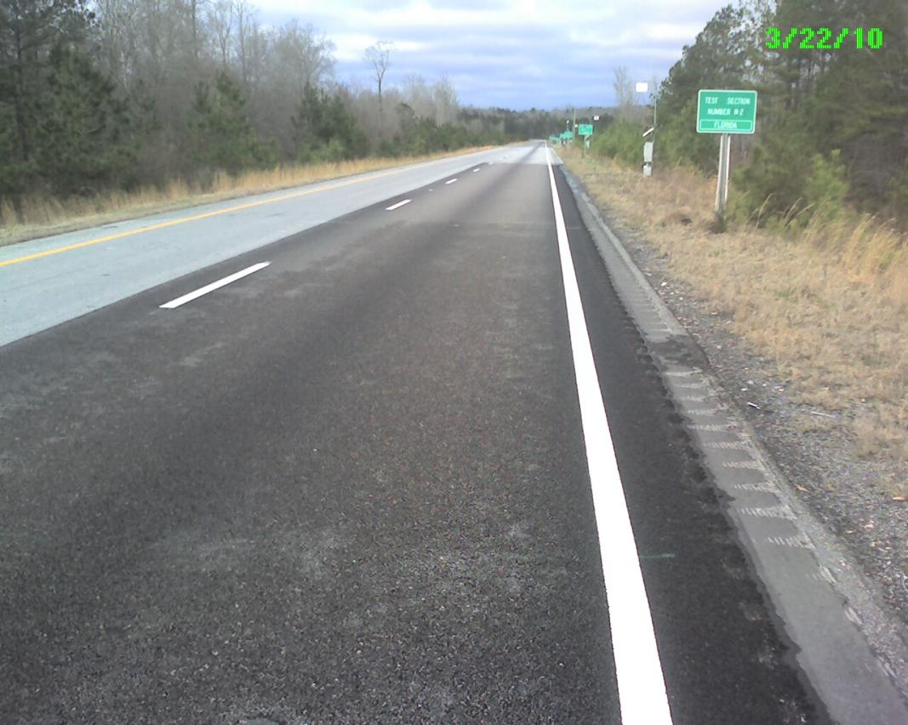
OGFC Surface Cracks (Tack Method)
Conventional Tack
Bonded

Slide 9
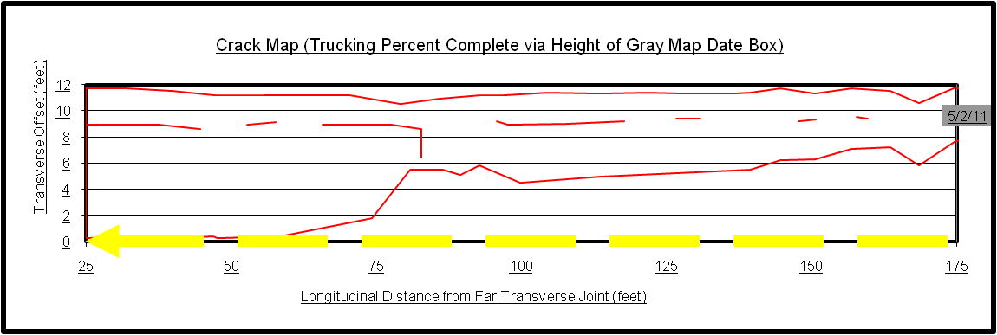
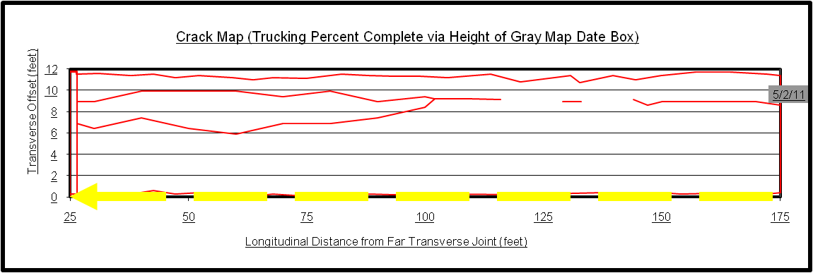
5/2/2011 Crack Maps (N2 / N1)

Slide 10
Functionality Issues
  Permeability
  Smoothness
  Structural Value
Notes:
Asphalt Technology Course
Introduction
10

Slide 11
Permeability

Slide 12
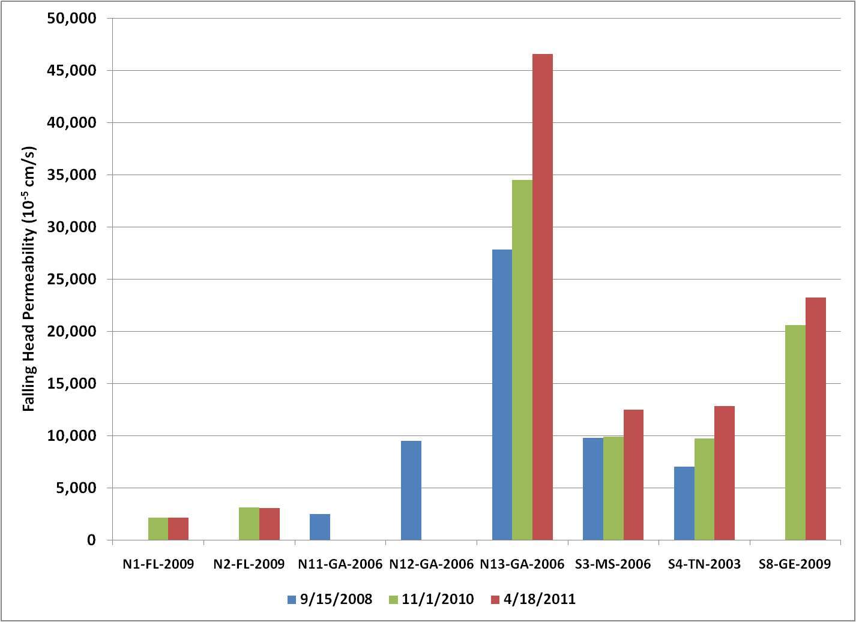
Same Mix Drains Better at 1¼”
S8 - 1¼”
Tacked
N1 - ¾”
Bonded
N2 - ¾”
Tacked

Slide 13
Smoothness

Slide 14
Change in Smoothness with Traffic

Slide 15
Structural Value

Slide 16
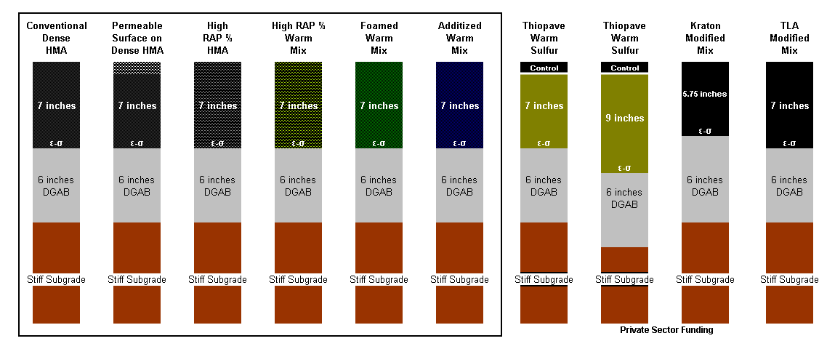
Structural Contribution of OGFC

Slide 17
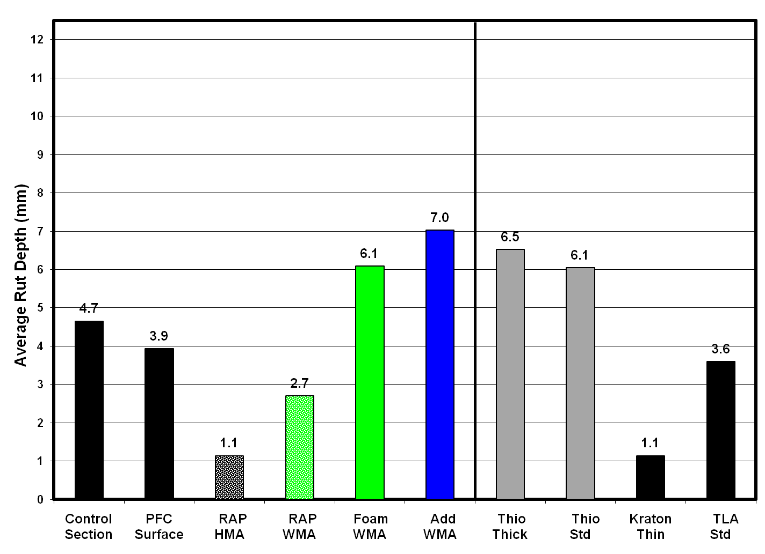
Similar Rutting Performance

Slide 18
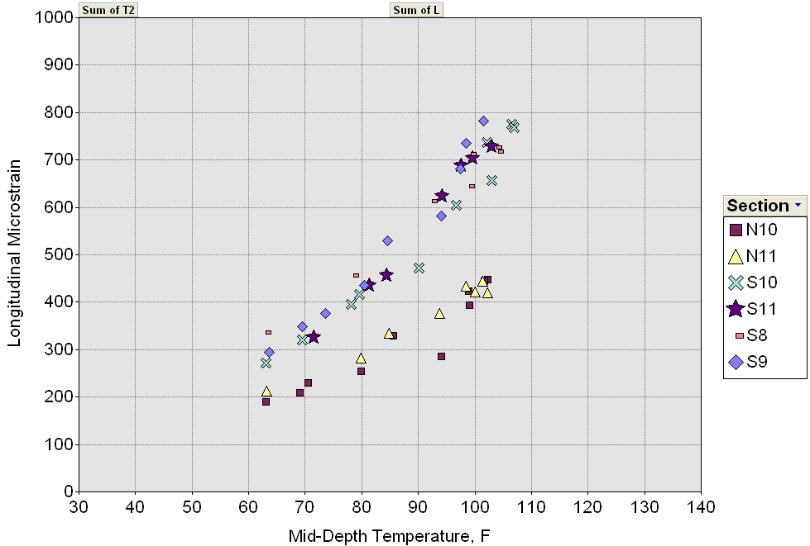
Similar Strain Response
Virgin Mixes
50% RAP

Slide 19
Questions??
Notes:
Asphalt Technology Course
Introduction
19

