Slide 1
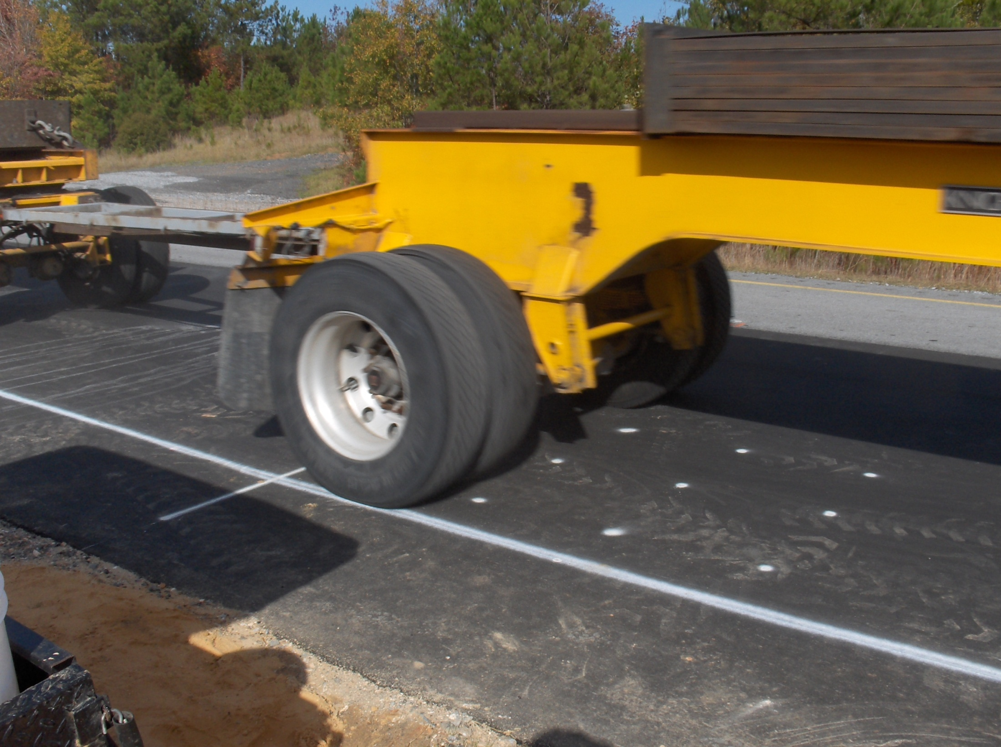
Structural Health Monitoring
Test Track Sponsor Meeting – May 11, 2011

Slide 2
Background
Damage vs time prediction is primary goal of M-E analysis/design
Predictions often based on “new” pavement properties
What happens to properties as pavements become damaged in field?
How do pavement responses change as pavement becomes damaged?
Can pavement properties and responses be used as indicators of structural health?

Slide 3
Objectives and Scope
Evaluate “health” of structural test sections
Use “health” as initial indicator of section performance
Weekly strain and pressure data at 68F
Backcalculated AC modulus at 68F

Slide 4
Test Sections
©

Slide 5
Instrumentation

Slide 6
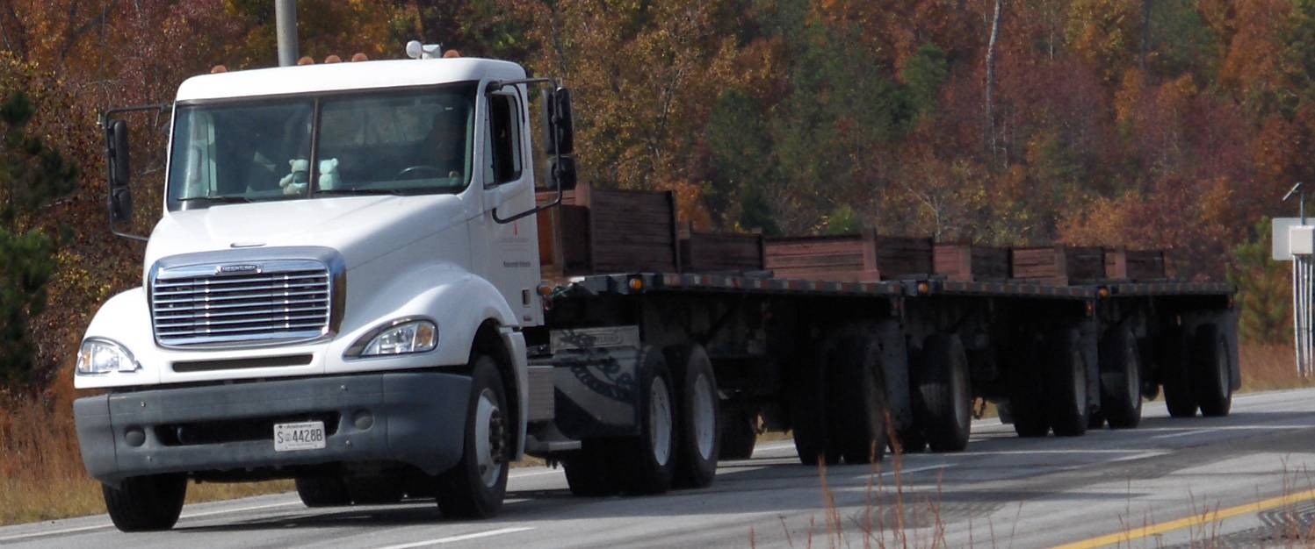
Dynamic Data Collection and Processing
111,291 Axle Events in Database
All sections
Weekly
3 passes of each truck at 45 mph
Analyze data according to axle type
  Steer (1)
  Tandem (2)
  Single (5)
Determine best hit per pass among working gauges
  95th percentile of all best hits from all passes
Record temperature at time of data collection

Slide 7
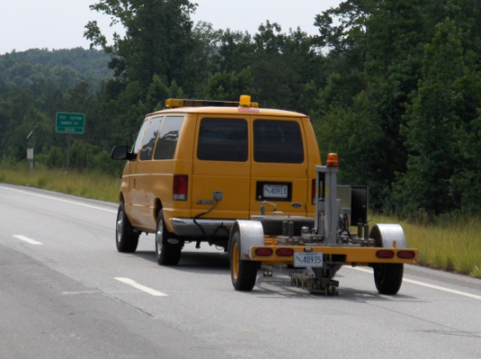
FWD Testing
Testing done 3 times/month
  Off day is for relative calibration of sensors
Dynatest 8000
9 sensors
  0, 8, 12, 18, 24, 36, 48, 60 and 72”
5.91” radius split plate
4 drop heights
  6, 9, 12 and 16 kip
  3 replicates at each height
Temps recorded at time of test
72,023 deflection basins

Slide 8
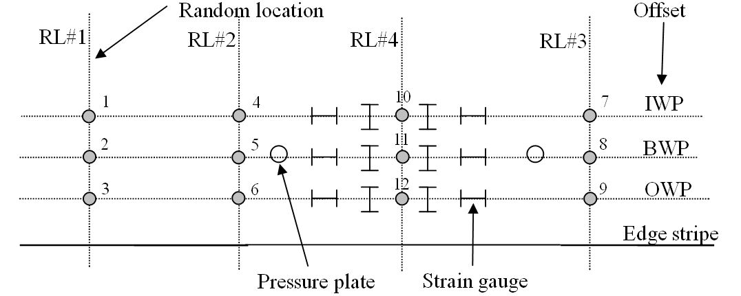
FWD Testing Locations
Traffic

Slide 9
Temperature Correction Example

Slide 10
Example – S9

Slide 11
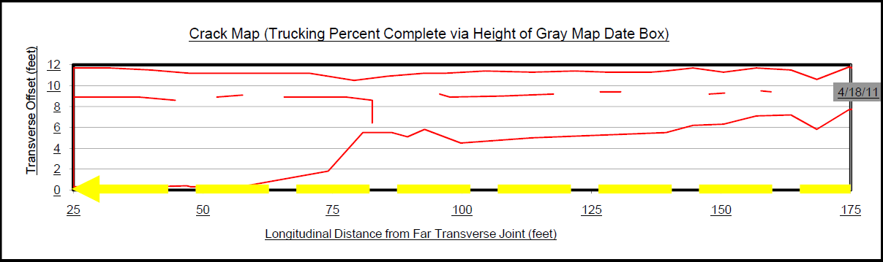
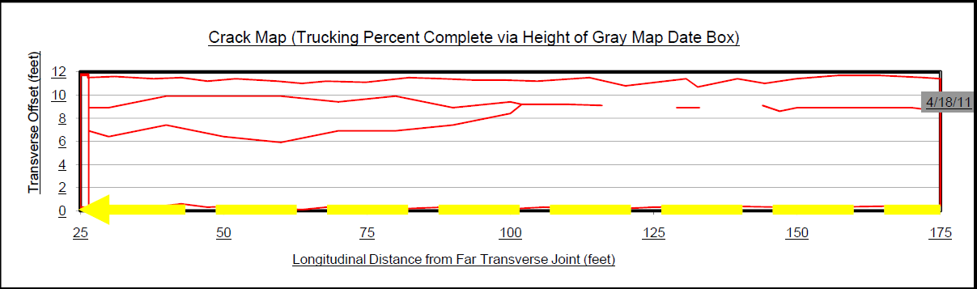
N1 (Mill and Inlay Spray Paver)
N2 (Mill and Inlay Ctrl)

Slide 12
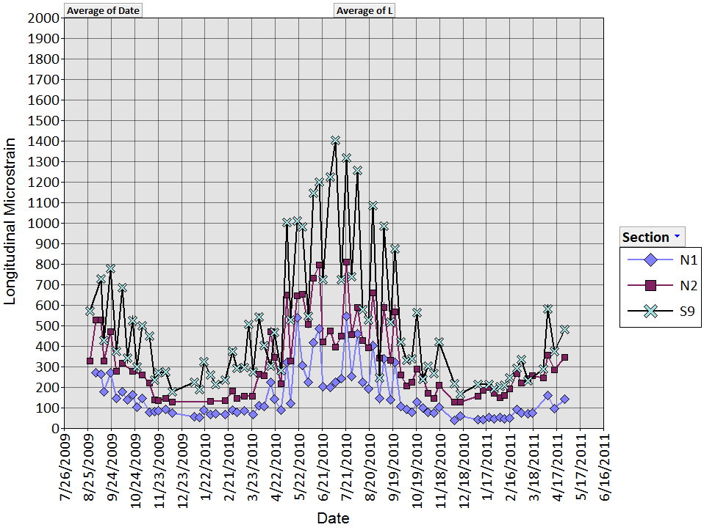
N1 (M/I Spray) & N2 (M/I Ctrl)
vs S9 (Ctrl)
Asphalt Strain

Slide 13
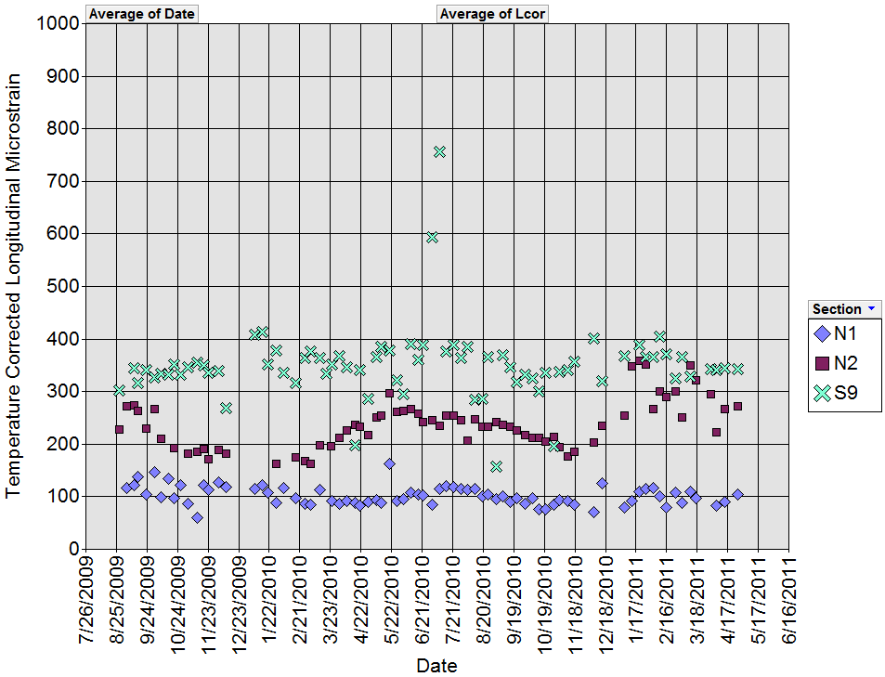
N1 (M/I Spray) & N2 (M/I Ctrl)
vs S9 (Ctrl)
First Cracking in N2
Asphalt Strain @ 68F

Slide 14
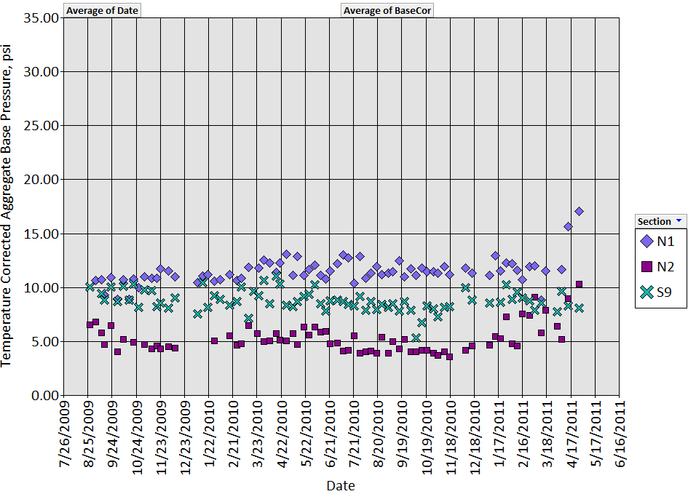
N1 (M/I Spray) & N2 (M/I Ctrl)
vs S9 (Ctrl)
Aggregate Base Pressure @ 68F

Slide 15
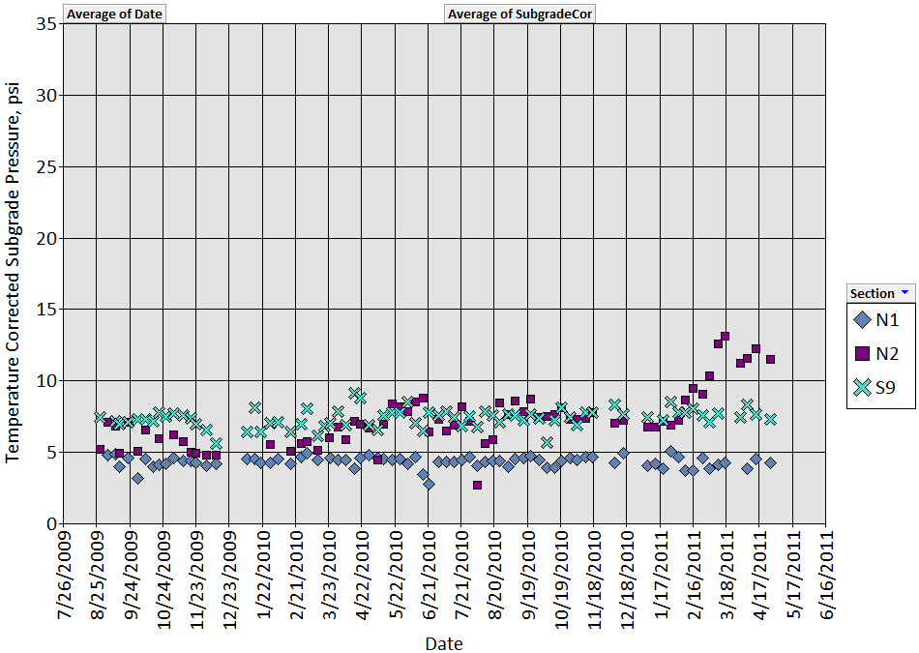
N1 (M/I Spray) & N2 (M/I Ctrl)
vs S9 (Ctrl)
Subgrade Pressure @ 68F

Slide 16
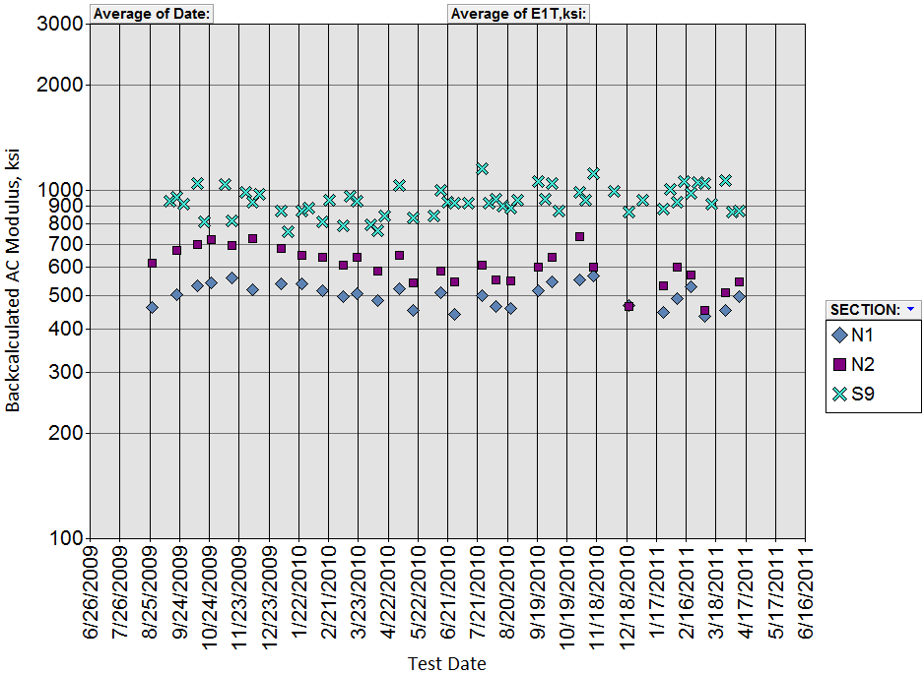
N1 (M/I Spray) & N2 (M/I Ctrl)
vs S9 (Ctrl)
Asphalt Modulus @ 68F

Slide 17
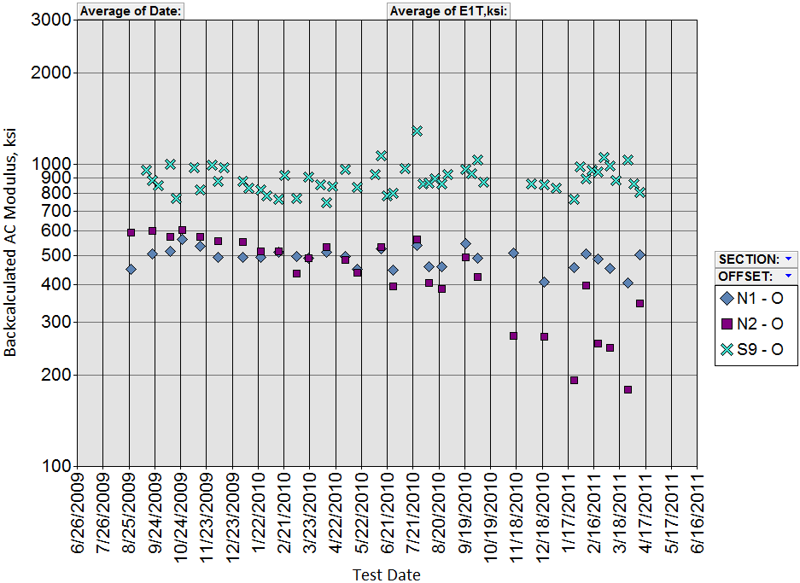
N1 (M/I Spray) & N2 (M/I Ctrl)
vs S9 (Ctrl)
AC Modulus @ 68F

Slide 18
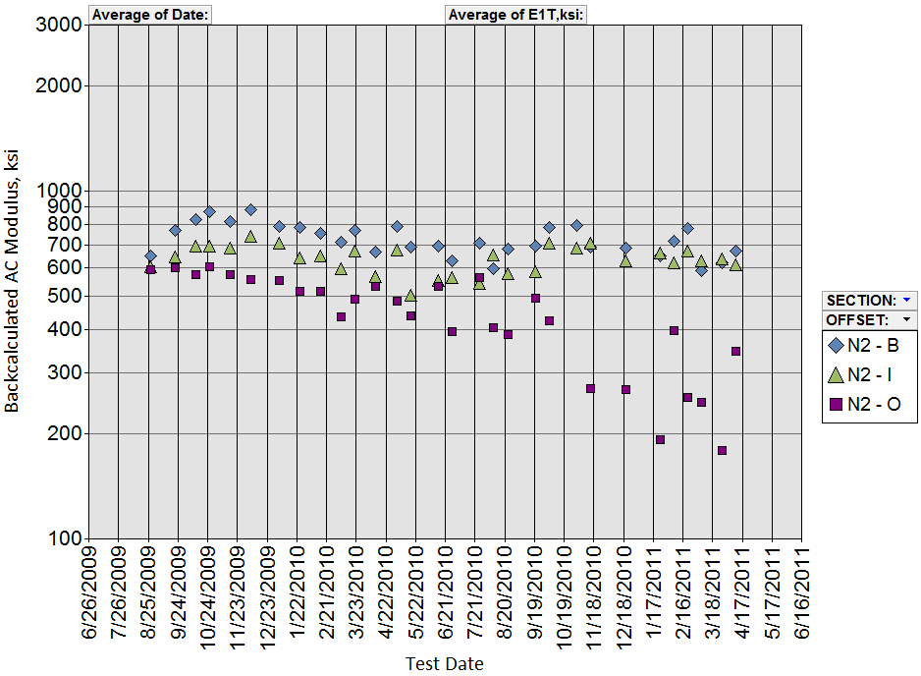
N2 (M/I Ctrl) - Wheelpath
AC Modulus @ 68F

Slide 19
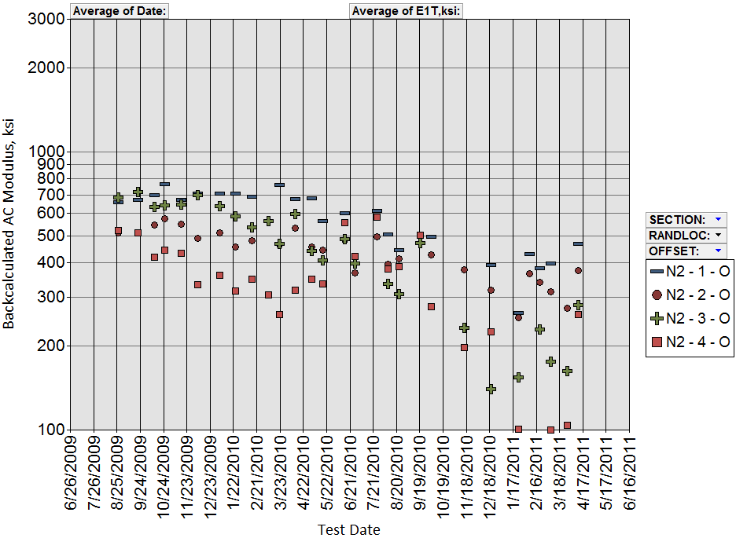
N2 (M/I Ctrl) – Random Location - OWP
AC Modulus @ 68F

Slide 20
N1 and N2 Summary
Spray-paver section (N1) performing better than control (N2) in terms of cracking
Increased pavement response noted in strain, and pressure responses versus time
Decreased AC modulus over time
  Especially in area of highest damage

Slide 21
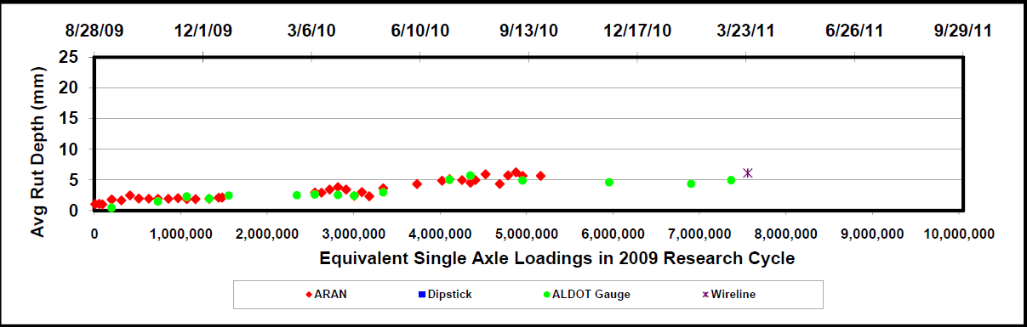
S9(Group Experiment Control)

Slide 22
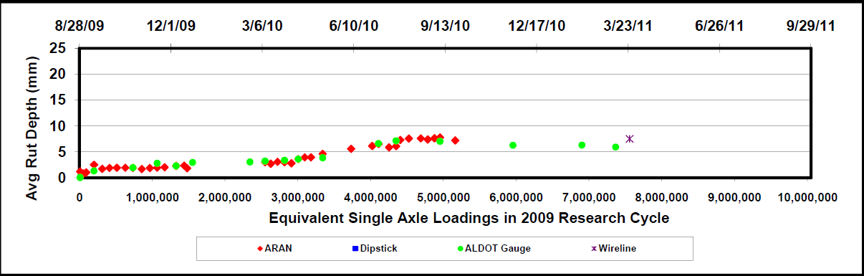

N5 (9” Thiopave)
N6(7” Thiopave)

Slide 23
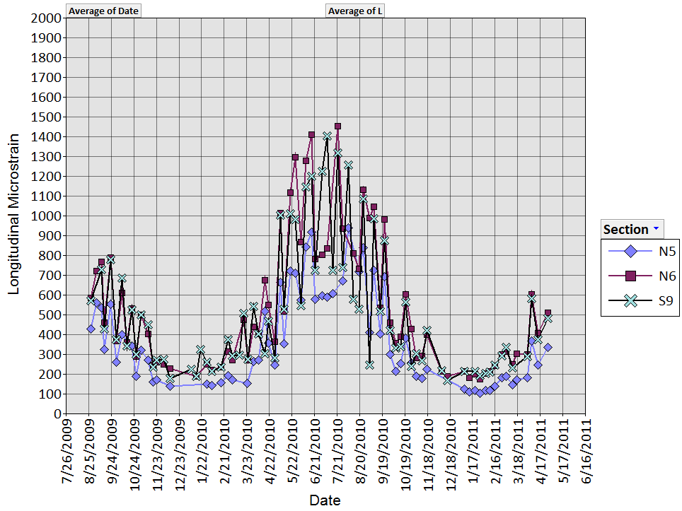
N5 (9” Thiopave) & N6 (7” Thiopave)
vs S9 (Ctrl)
Asphalt Strain

Slide 24
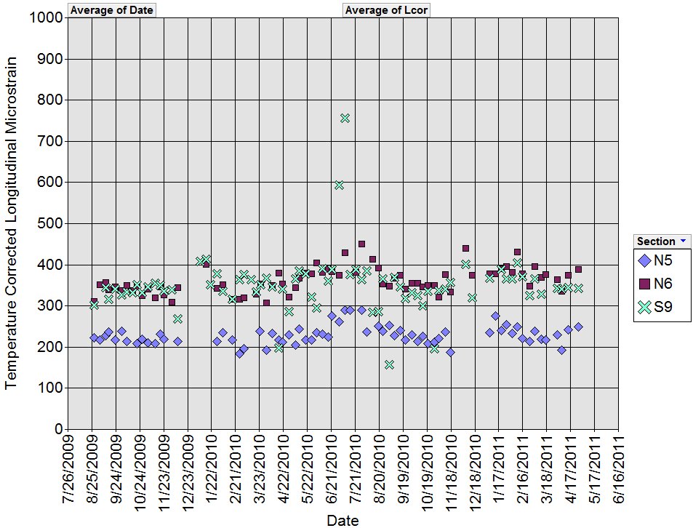
N5 (9” Thiopave) & N6 (7” Thiopave)
vs S9 (Ctrl)
Asphalt Strain @ 68F

Slide 25
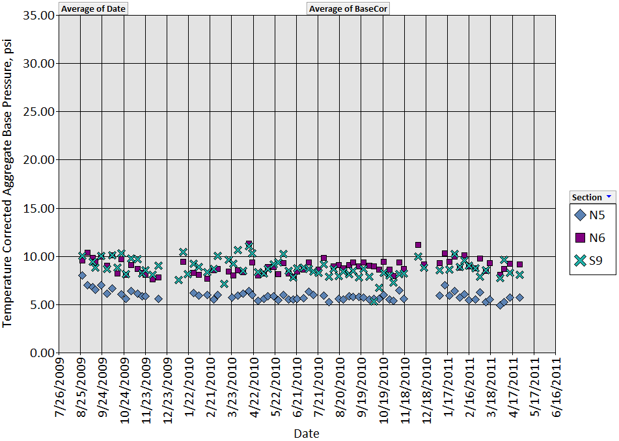
N5 (9” Thiopave) & N6 (7” Thiopave)
vs S9 (Ctrl)
Aggregate Base Pressure @ 68F

Slide 26
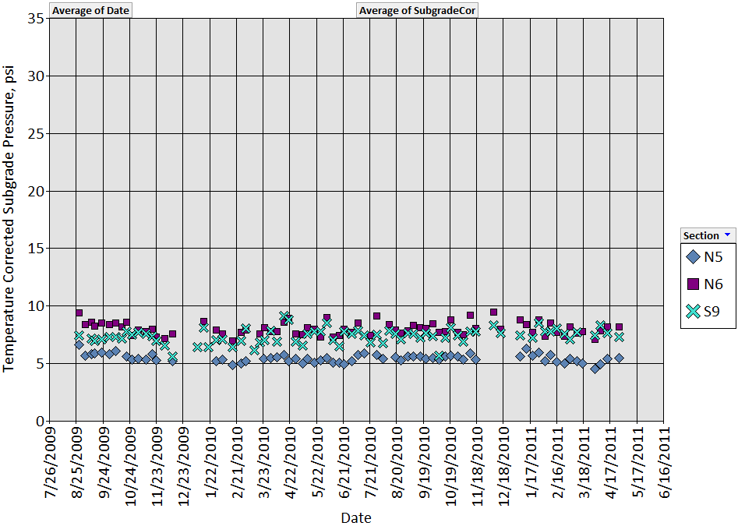
N5 (9” Thiopave) & N6 (7” Thiopave)
vs S9 (Ctrl)
Subgrade Pressure @ 68F

Slide 27
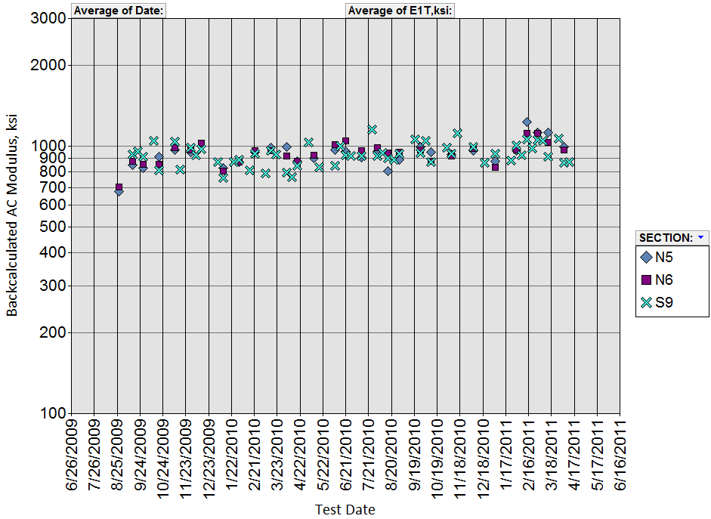
N5 (9” Thiopave) & N6 (7” Thiopave)
vs S9 (Ctrl)
AC Modulus @ 68F

Slide 28
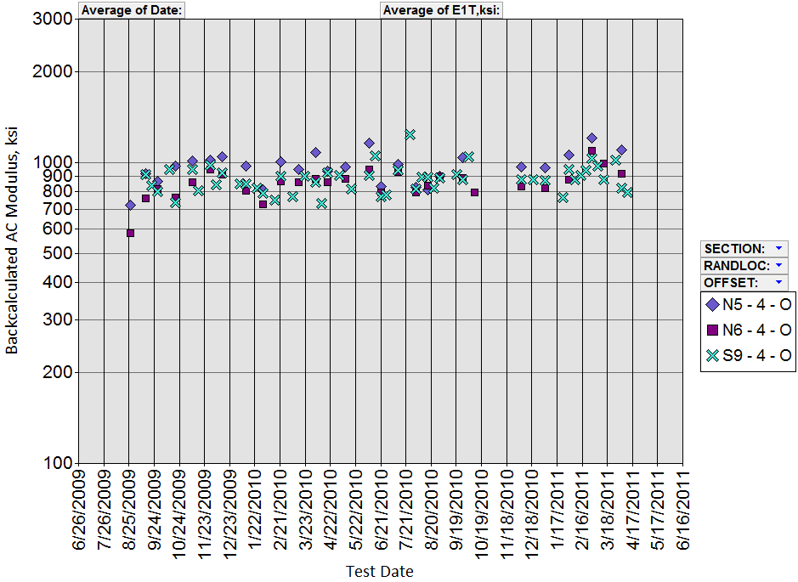
N5 (9” Thiopave) & N6 (7” Thiopave)
vs S9 (Ctrl)
AC Modulus @ 68F

Slide 29
Thiopave Summary
Both sections are performing well
  No cracking
  Rutting comparable to control
No signs of structural distress in strain data
No signs of structural distress in FWD data

Slide 30
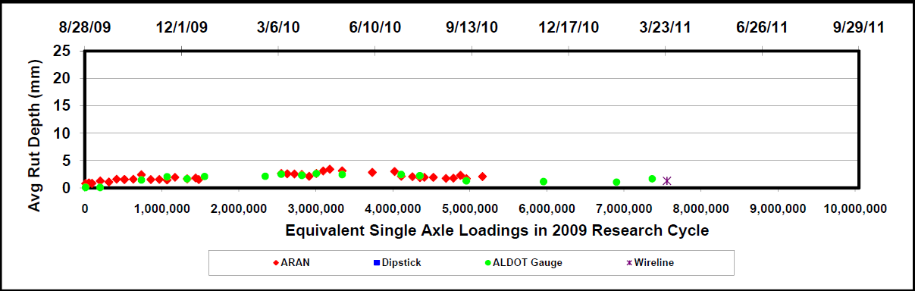
N7 (Kraton)

Slide 31
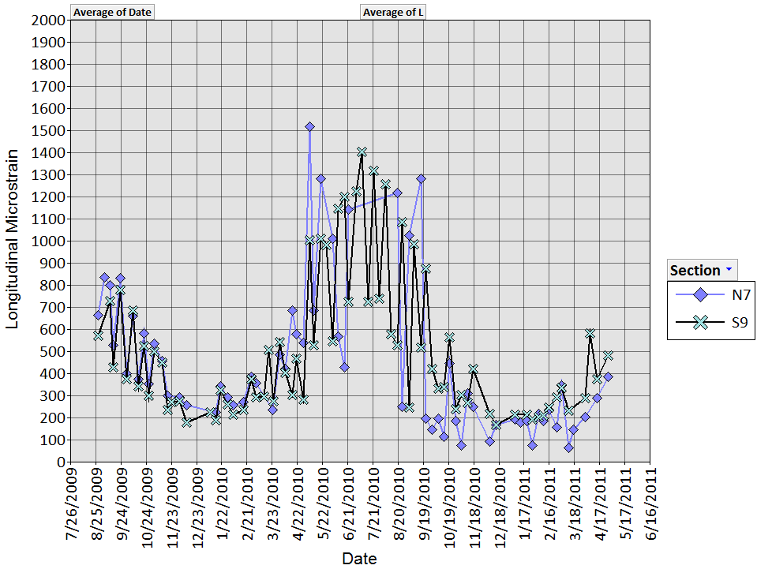
N7 (Kraton)
vs S9 (Ctrl)
Asphalt Strain

Slide 32
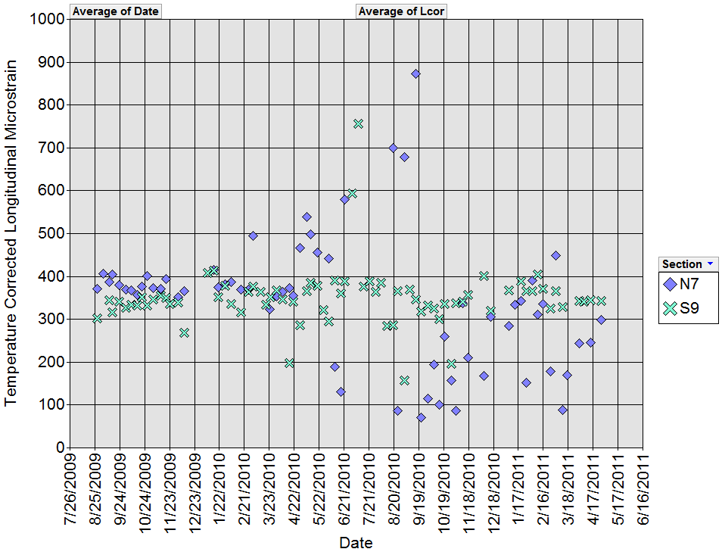
N7 (Kraton) vs S9 (Ctrl)
Asphalt Strain @ 68F

Slide 33
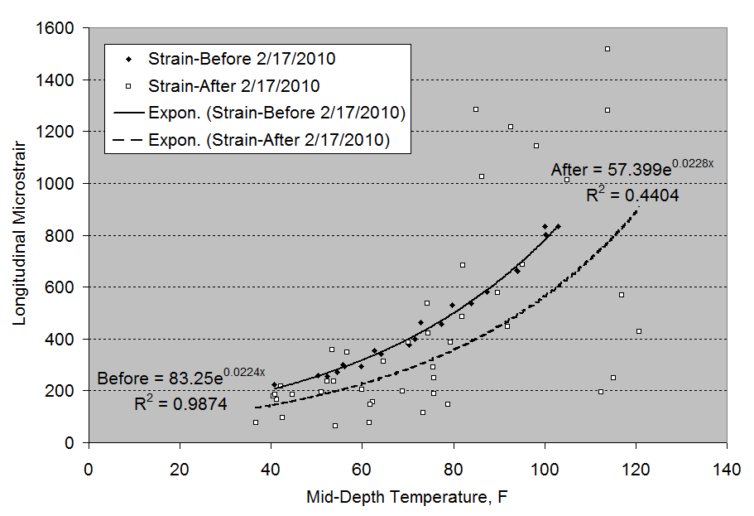
N7 (Kraton) Before and After 2/17/2010

Slide 34
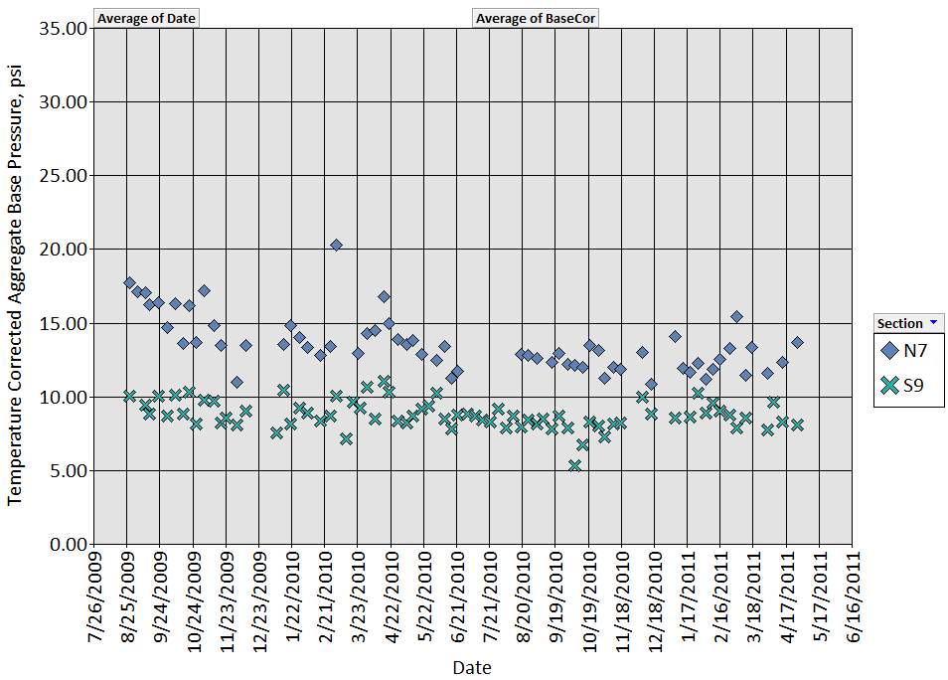
N7 (Kraton) vs S9 (Ctrl)
Aggregate Base Pressure @ 68F

Slide 35
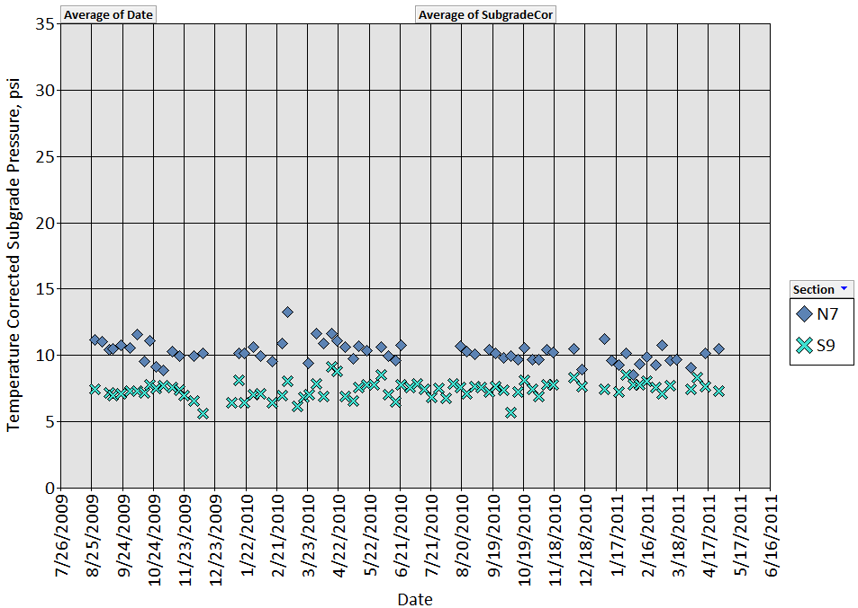
N7 (Kraton) vs S9 (Ctrl)
Subgrade Pressure @ 68F

Slide 36
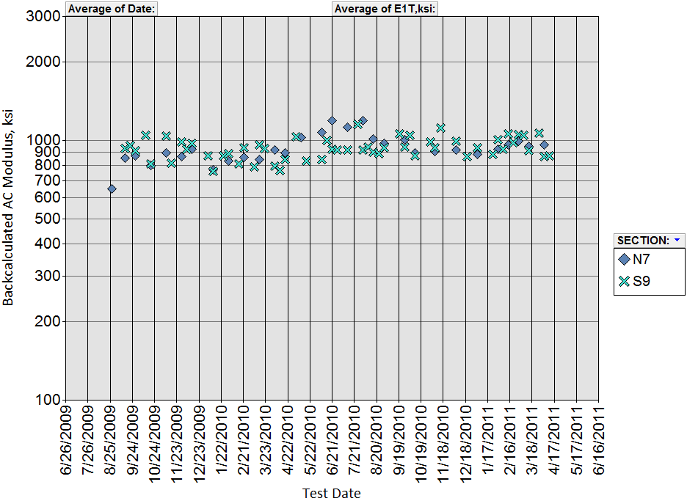
N7 (Kraton) vs S9 (Ctrl)
AC Modulus @ 68F

Slide 37
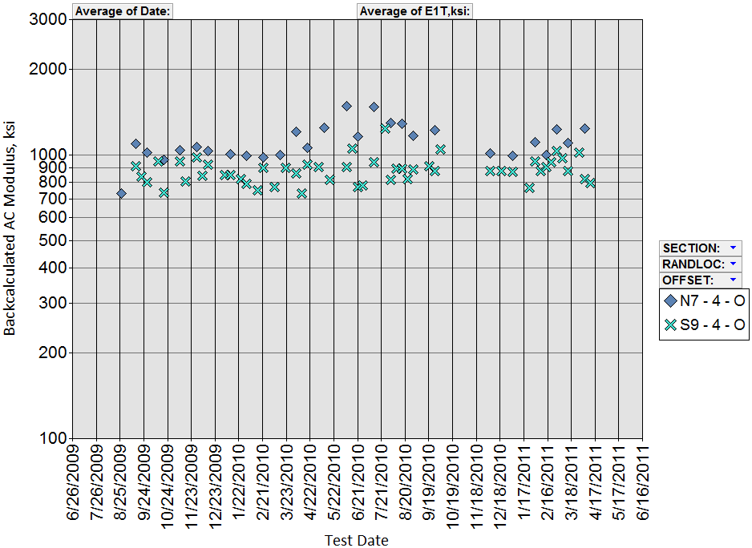
N7 (Kraton) vs S9 (Ctrl)
AC Modulus @ 68F

Slide 38
Kraton Summary
Kraton rutting is about ½ of the control
No cracking yet evident
Measured strain response erratic since Feb ’10
  Not observed in pressure data sets
AC modulus erratic since Feb ’10
  Especially pronounced in gauge array
    Bonding problem?

Slide 39
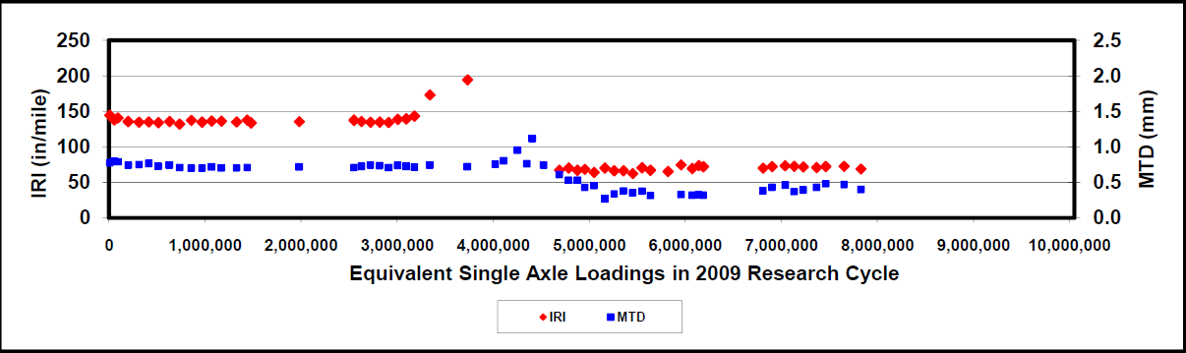
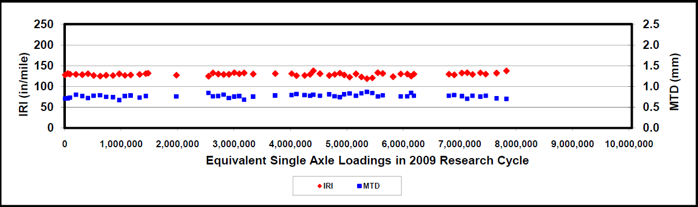
N8 (10” OK/Kraton – Heavily Rehabilitated)
Section Milled and Inlayed 8/16/2010
N9(14” OK Perpetual)

Slide 40
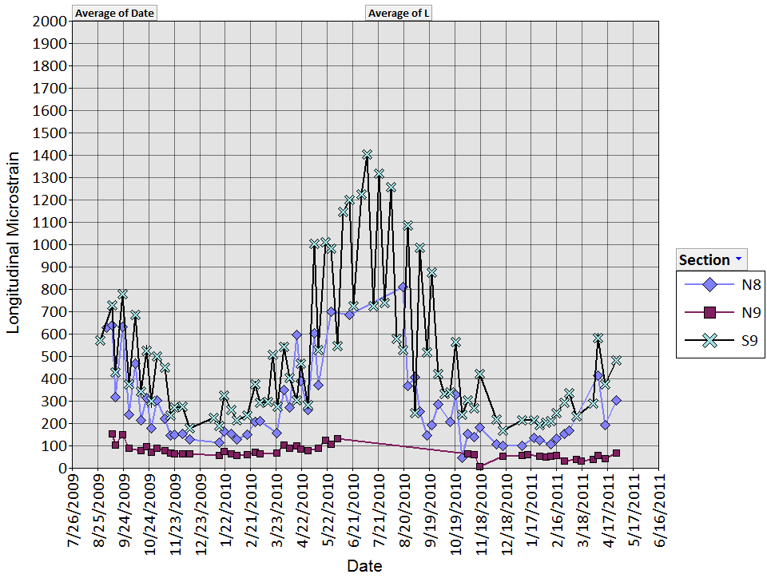
N8 (OK 10”) & N9 (OK 14”)
vs S9 (Ctrl)
Asphalt Strain

Slide 41
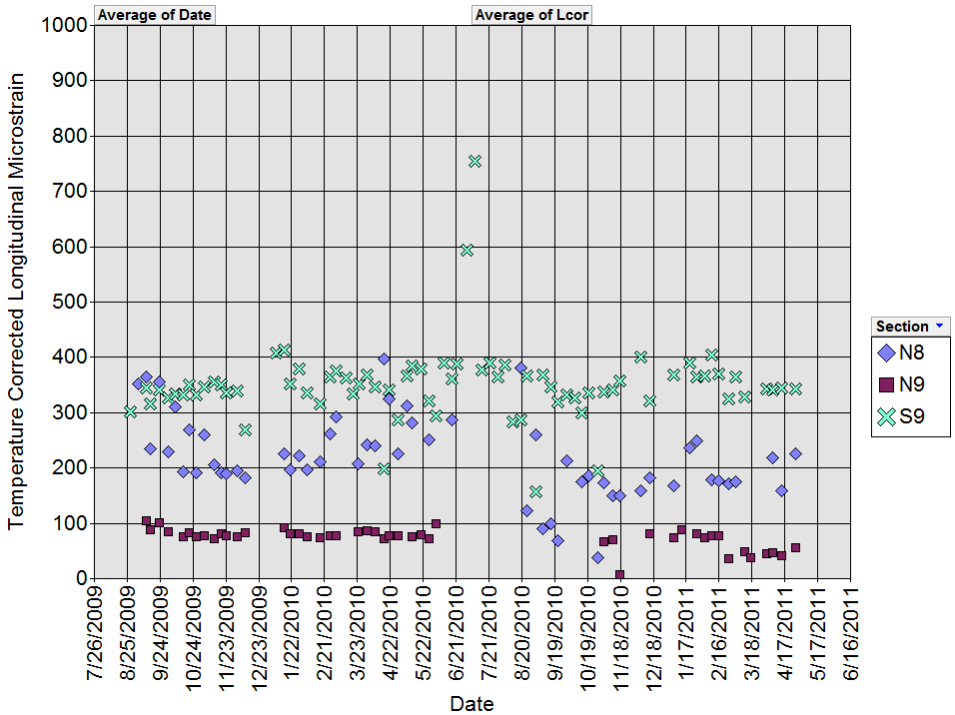
N8 (OK 10”) & N9 (OK 14”)
vs S9 (Ctrl)
N8 Repair
Asphalt Strain @ 68F

Slide 42
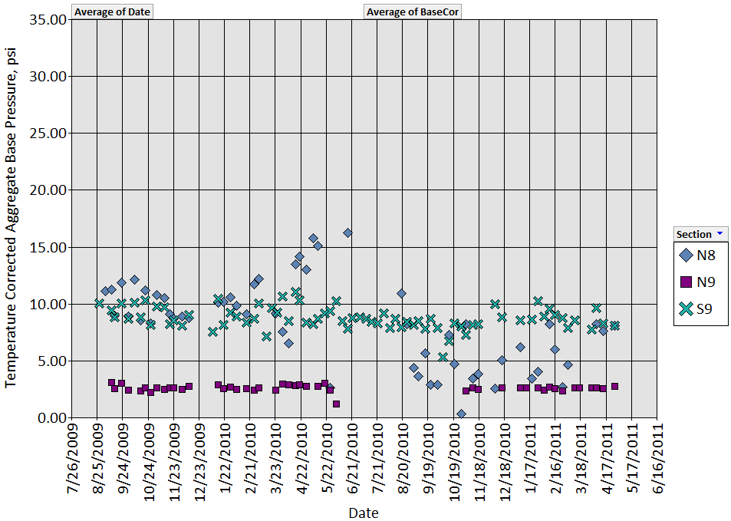
N8 (OK 10”) & N9 (OK 14”)
vs S9 (Ctrl)
N8 Repair
Aggregate Base Pressure @ 68F

Slide 43
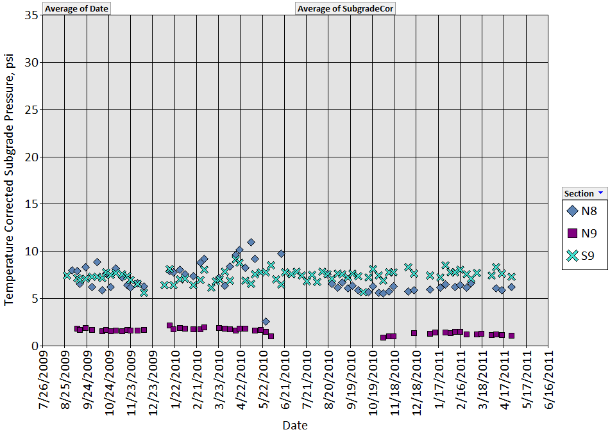
N8 (OK 10”) & N9 (OK 14”)
vs S9 (Ctrl)
N8 Repair
Subgrade Pressure @ 68F

Slide 44
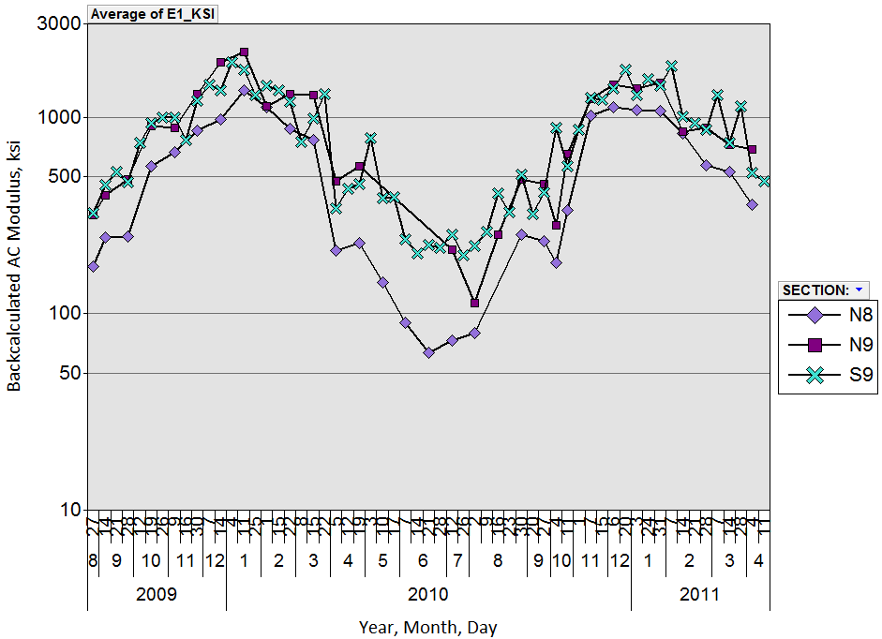
N8 (OK 10”) & N9 (OK 14”)
vs S9 (Ctrl)
N8 Repair
AC Modulus

Slide 45
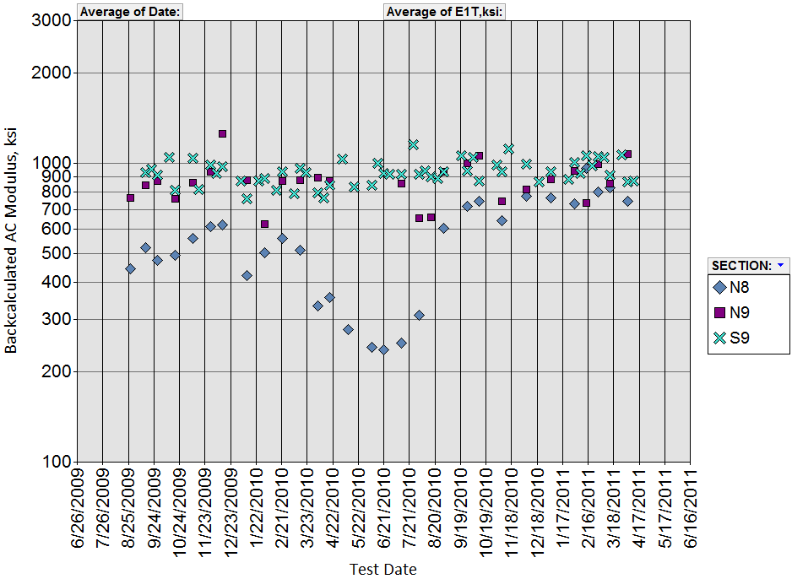
N8 (OK 10”) & N9 (OK 14”)
vs S9 (Ctrl)
N8 Repair
AC Modulus @ 68F

Slide 46
OK/Kraton Summary
N9 continues to perform well. Some minor top-down cracking in inside wheelpath
Repair of N8 has been effective so far
  Modulus increase
  Pavement response decrease

Slide 47

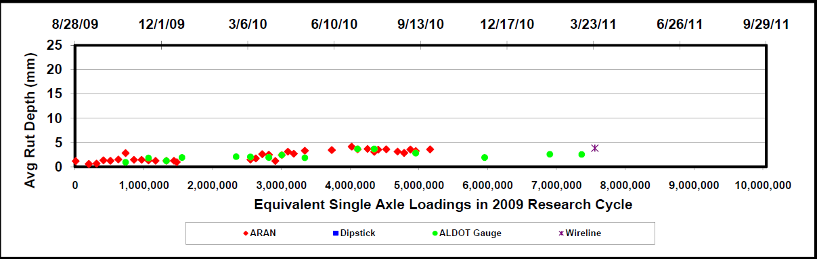
N10 (50% RAP)
N11(50% RAP WMA)

Slide 48
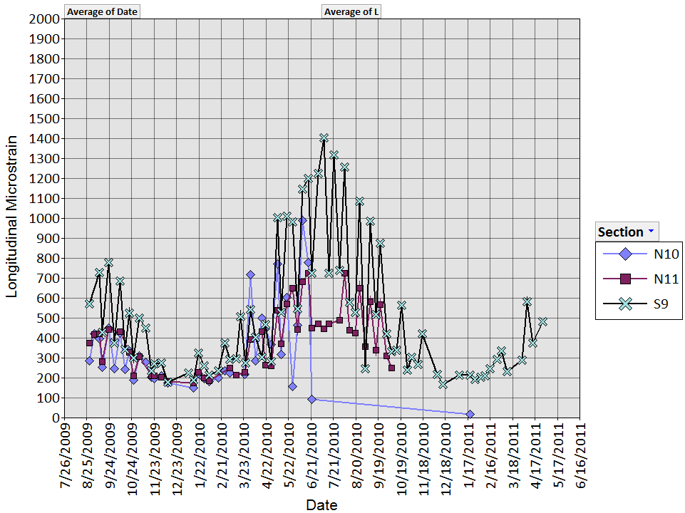
N10 (50%RAP) & N11 (50%RAP WMA)
vs S9 (Ctrl)
Asphalt Strain

Slide 49
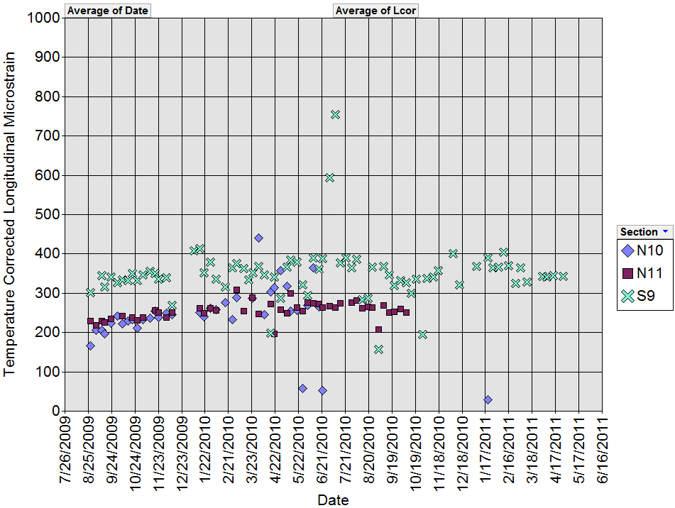
N10 (50%RAP) & N11 (50%RAP WMA)
vs S9 (Ctrl)
Asphalt Strain @ 68F

Slide 50
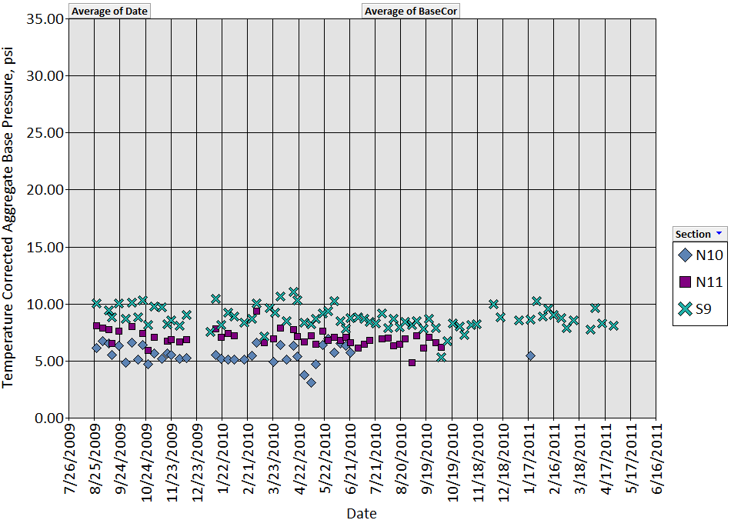
N10 (50%RAP) & N11 (50%RAP WMA)
vs S9 (Ctrl)
Aggregate Base Pressure @ 68F

Slide 51
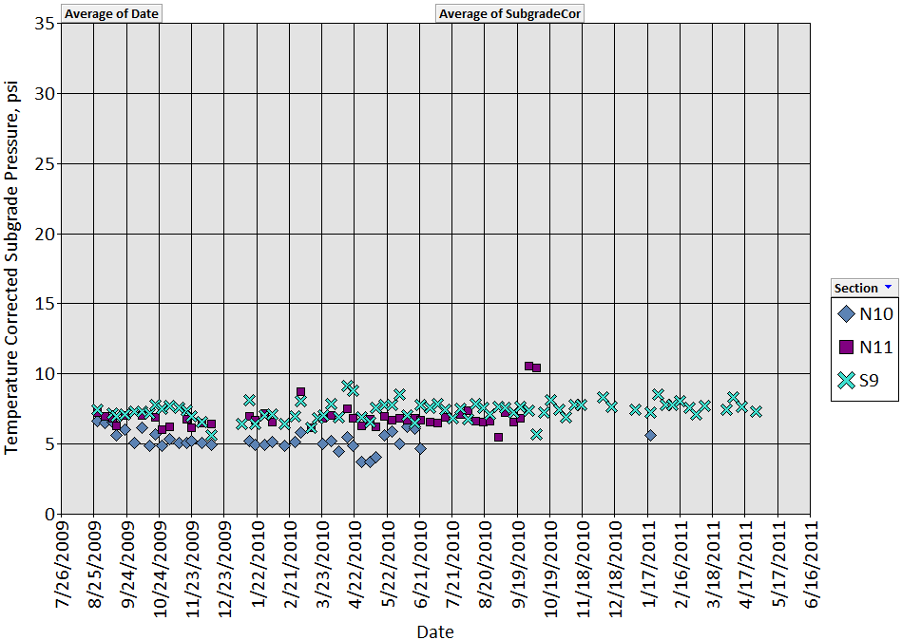
N10 (50%RAP) & N11 (50%RAP WMA)
vs S9 (Ctrl)
Subgrade Pressure @ 68F

Slide 52
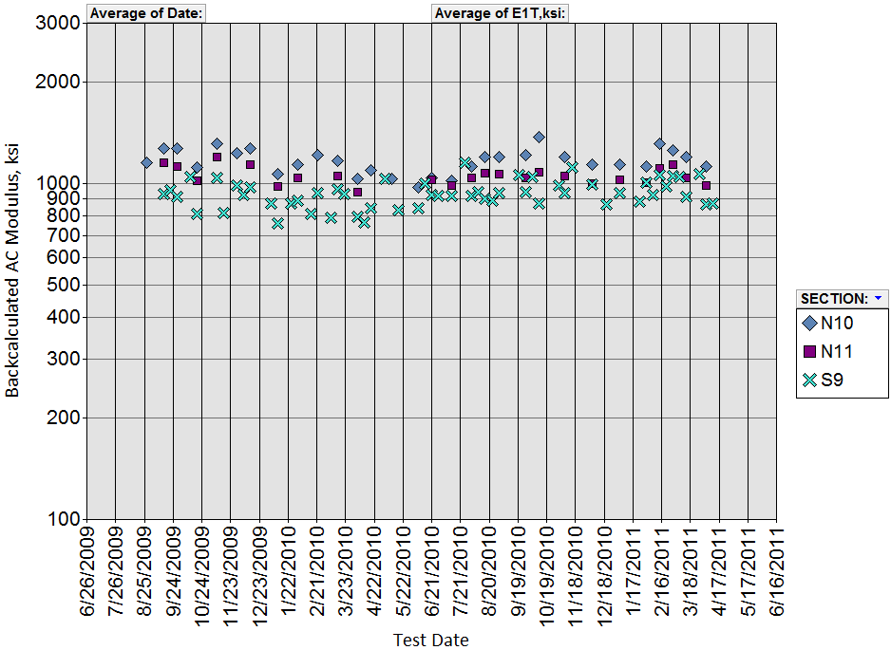
N10 (50%RAP) & N11 (50%RAP WMA)
vs S9 (Ctrl)
AC Modulus @ 68F

Slide 53
50% RAP Summary
No cracking in either section
50% RAP HMA rut performance better than RAP WMA section, but both < 5 mm
  Both better than control section
No observed changes in pavement response or properties
  Need to process more recent response data

Slide 54
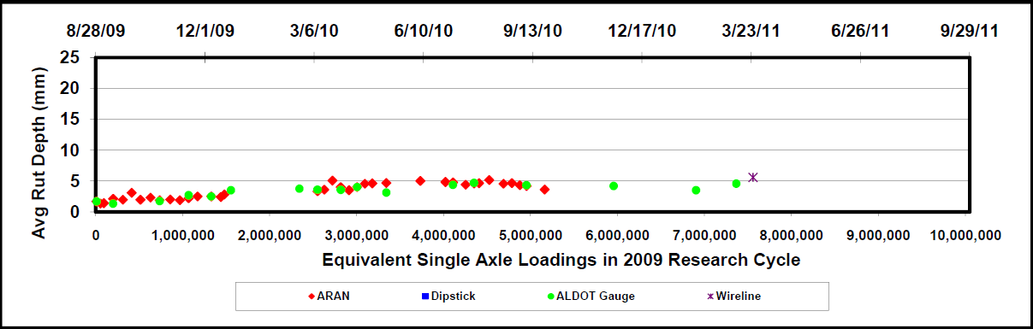
S8(OGFC)

Slide 55
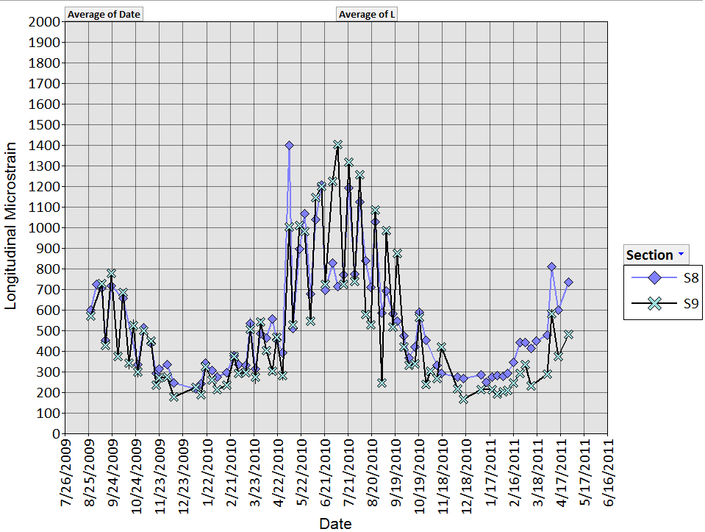
S8 (OGFC)
vs S9 (Ctrl)
Asphalt Strain

Slide 56
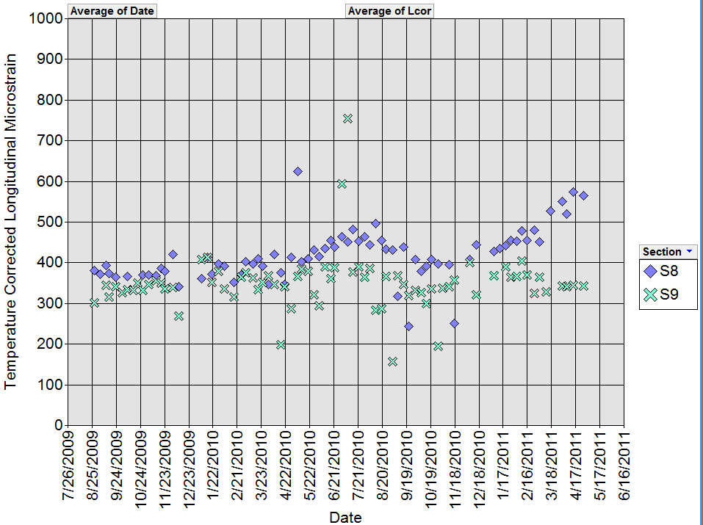
S8 (OGFC)
vs S9 (Ctrl)
Asphalt Strain @ 68F

Slide 57
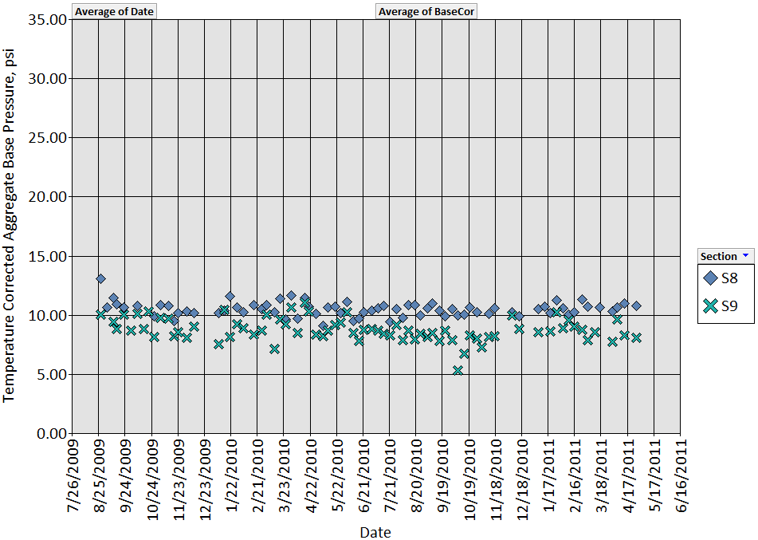
S8 (OGFC)
vs S9 (Ctrl)
Aggregate Base Pressure @ 68F

Slide 58
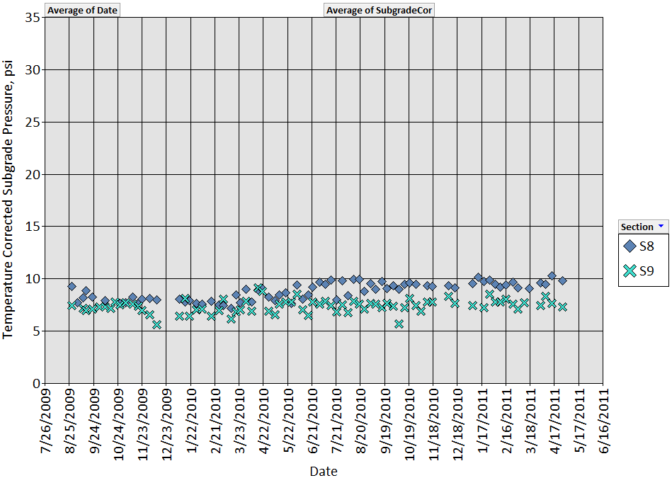
S8 (OGFC)
vs S9 (Ctrl)
Subgrade Pressure @ 68F

Slide 59
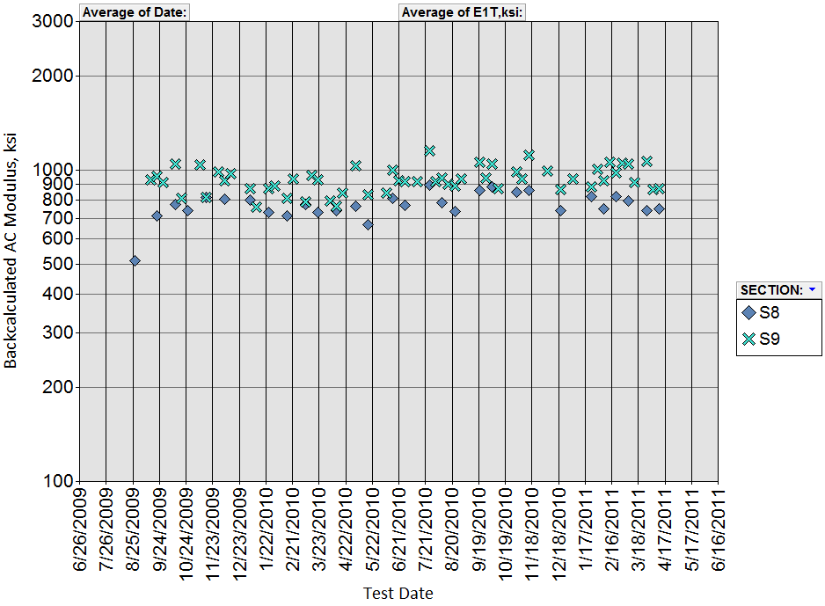
S8 (OGFC)
vs S9 (Ctrl)
AC Modulus @ 68F

Slide 60

S8 (OGFC) - Wheelpath
AC Modulus @ 68F

Slide 61
OGFC Summary
Rutting comparable to control section
No cracking…yet
Strain response appears to be increasing significantly since Nov 2010
AC modulus more variable since May 2010

Slide 62


S10 (WMA Foam)
S11(WMA Additive)

Slide 63

S10 (WMA-Foam) & S11 (WMA-Additive)
vs S9 (Ctrl)
Asphalt Strain

Slide 64

S10 (WMA-Foam) & S11 (WMA-Additive)
vs S9 (Ctrl)
Asphalt Strain @ 68F

Slide 65

S10 (WMA-Foam) & S11 (WMA-Additive)
vs S9 (Ctrl)
Aggregate Base Pressure @ 68F

Slide 66

S10 (WMA-Foam) & S11 (WMA-Additive)
vs S9 (Ctrl)
Subgrade Pressure @ 68F

Slide 67

S10 (WMA-Foam) & S11 (WMA-Additive)
vs S9 (Ctrl)
AC Modulus @ 68F

Slide 68

S10 (WMA-Foam) & S11 (WMA-Additive)
vs S9 (Ctrl)
AC Modulus @ 68F

Slide 69
WMA Summary
Both sections exceeded control section rut depths by several mm
No cracking
Strain, pressure and modulus data are reasonably constant

Slide 70

S12(TLA)

Slide 71

S12 (TLA)
vs S9 (Ctrl)
Asphalt Strain

Slide 72

S12 (TLA)
vs S9 (Ctrl)
Asphalt Strain @ 68F

Slide 73

S12 (TLA) – Before and After 5/20/2010

Slide 74

S12 (TLA)
vs S9 (Ctrl)
Aggregate Base Pressure @ 68F

Slide 75

S12 (TLA)
vs S9 (Ctrl)
Subgrade Pressure @ 68F

Slide 76

S12 (TLA)
vs S9 (Ctrl)
AC Modulus @ 68F

Slide 77

S12 (TLA)-Wheelpath
AC Modulus @ 68F

Slide 78

S12 (TLA) – Random Location
AC Modulus @ 68F

Slide 79
TLA Summary
Slightly less rutting than control
No cracking
Pressure readings reasonably constant
Strain measurements erratic since May 2010
  Also observed in AC modulus data

Slide 80
Summary of Significant Findings
Measurable improvement in spray-paver mill/inlay section
  Pavement response and AC modulus more stable over time
Thiopave sections behavior & performance ≥ control
Kraton section rutting ½ of control
  Erratic strain and FWD data, may have slippage in this section
Perpetual pavement sections
  N8 experienced significant improvement with Kraton repair
  N9 continues to perform well with some minor top-down cracking
50% RAP sections behavior & performance ≥ control
  Less rutting than control, no cracking and stable structural parameters
OGFC and control have comparable rutting performance
  OGFC is beginning to show signs that cracking will occur soon
WMA sections rutting more than control section
  Other structural characteristics are constant
TLA has slightly less rutting than control
  Strain and AC modulus became erratic in May 2010

Slide 81
Future Work
Continue to monitor…
  Surface performance
    Cracking, rutting, IRI
  Strain and pressure response
  Deflections under FWD
Build “complete” response histories
  Use hourly temperature data
MEPDG simulations
  Validation and Calibration
Forensic evaluations at end of traffic
  Trenches
  Cores
  Bond strength testing

Slide 82

Questions?

