Slide 1
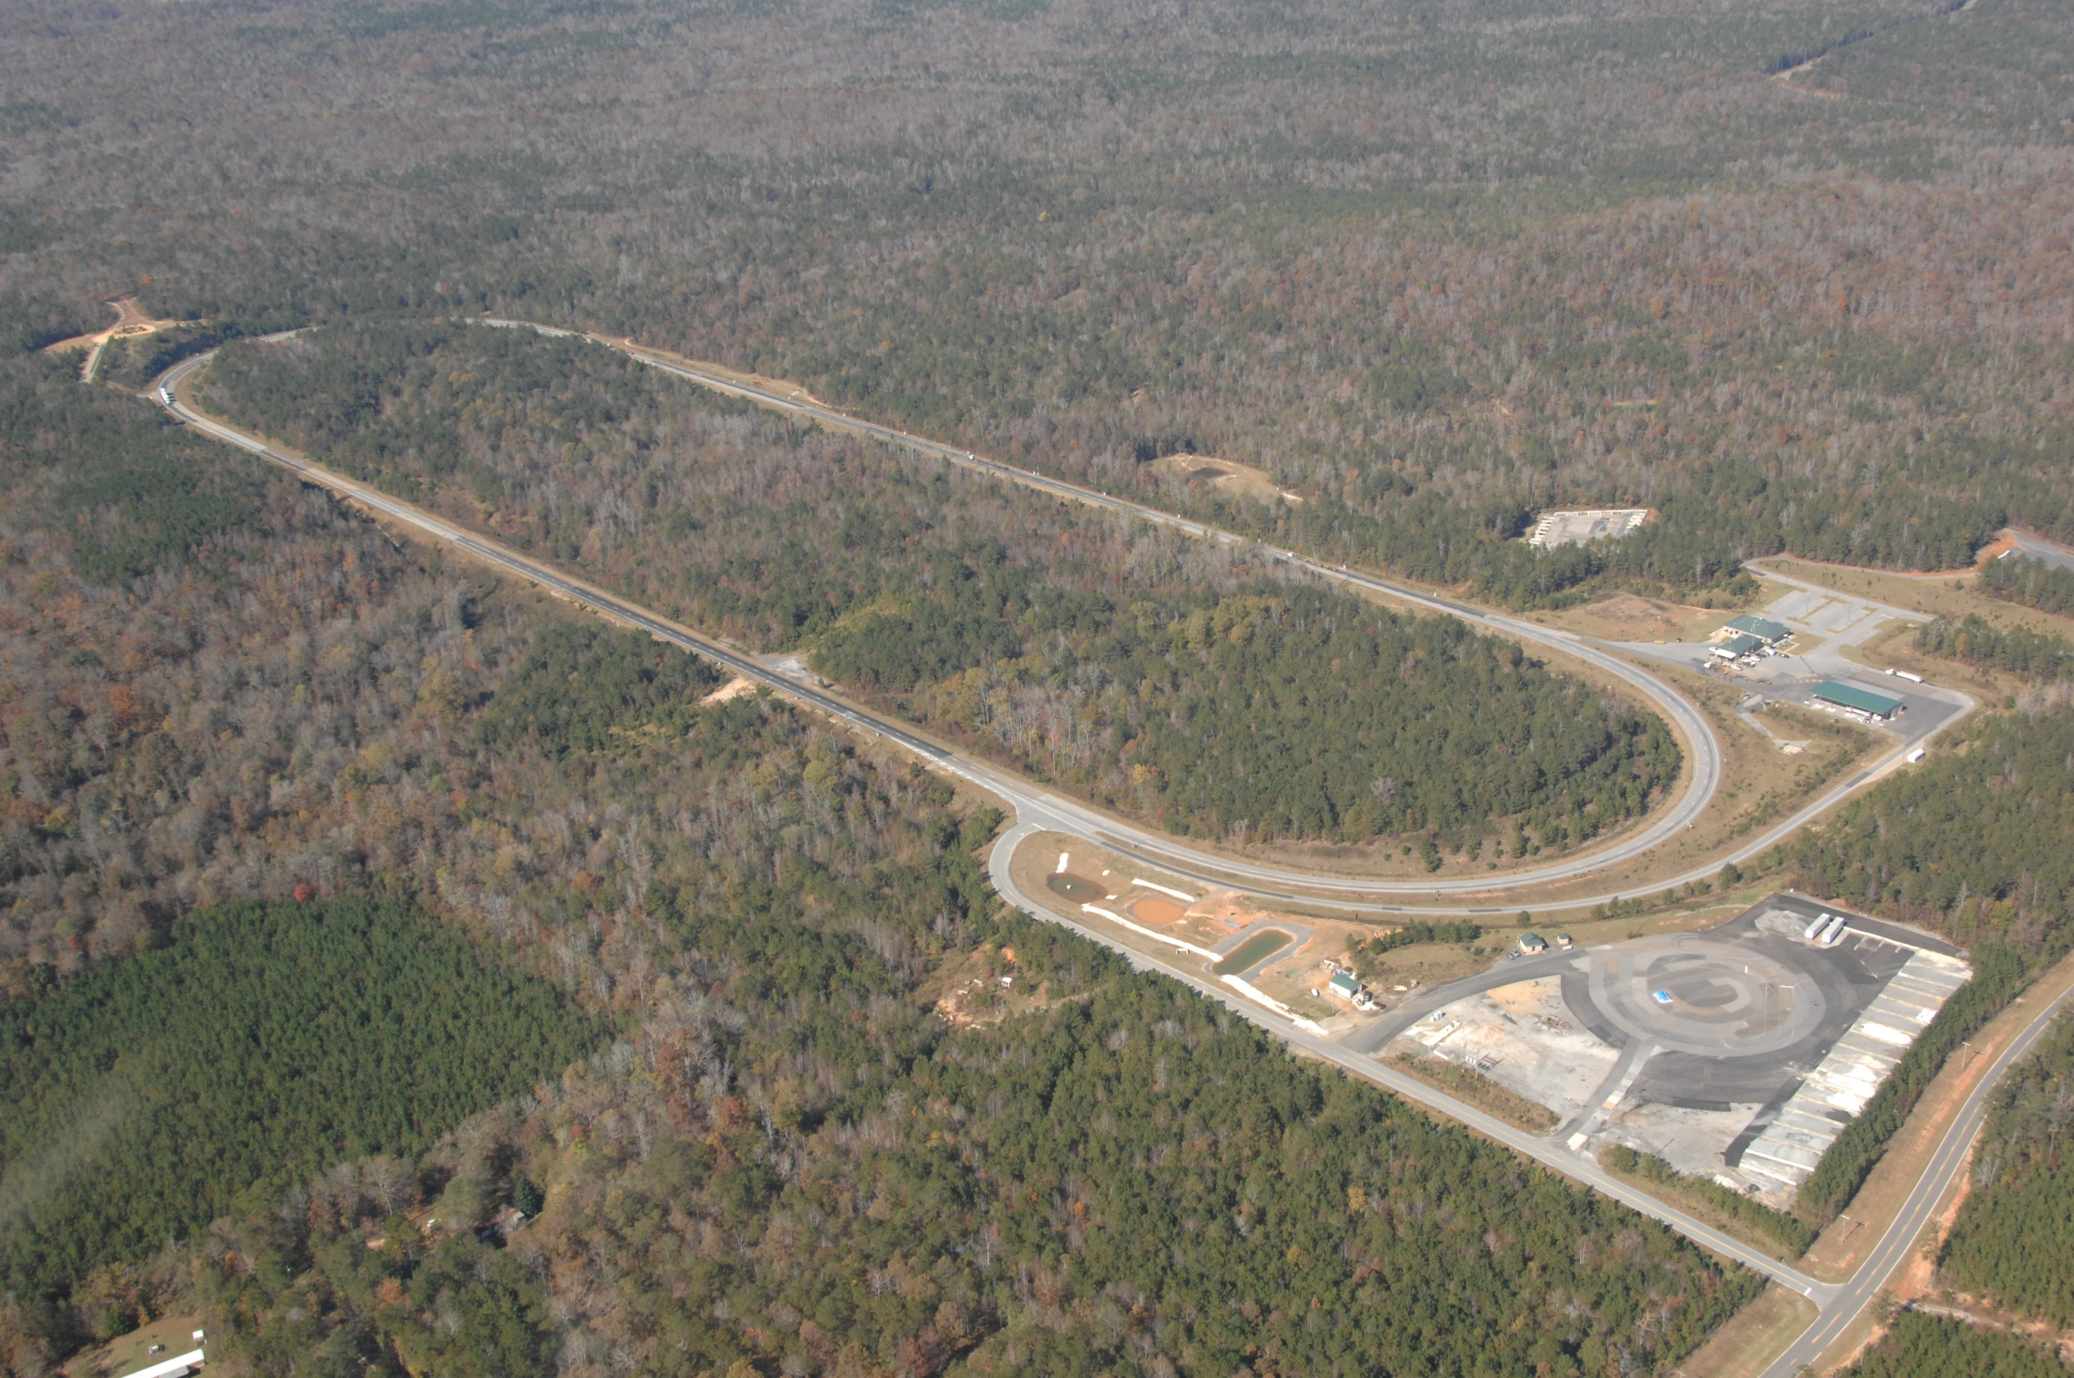
NCAT Pavement Test Track
Welcome to the
5/11/11 Track Sponsor Meeting
The meeting will begin at 7:30 central time

Slide 2
Morning Agenda
Operations & field performance by Buzz Powell
Structural performance update by Dave Timm
Break
Durability of PFC Surfaces by Don Watson
Ground Tire Rubber Modified Binder by Nam Tran
Lab to Field Comparisons by Buzz Powell
Planning for the 2012 Track by Buzz Powell

Slide 3
Track Operations

Slide 4
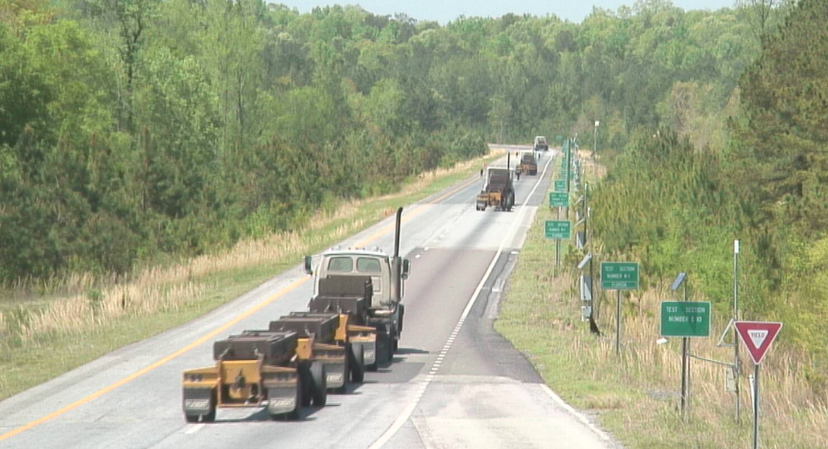
Trucking Operations

Slide 5
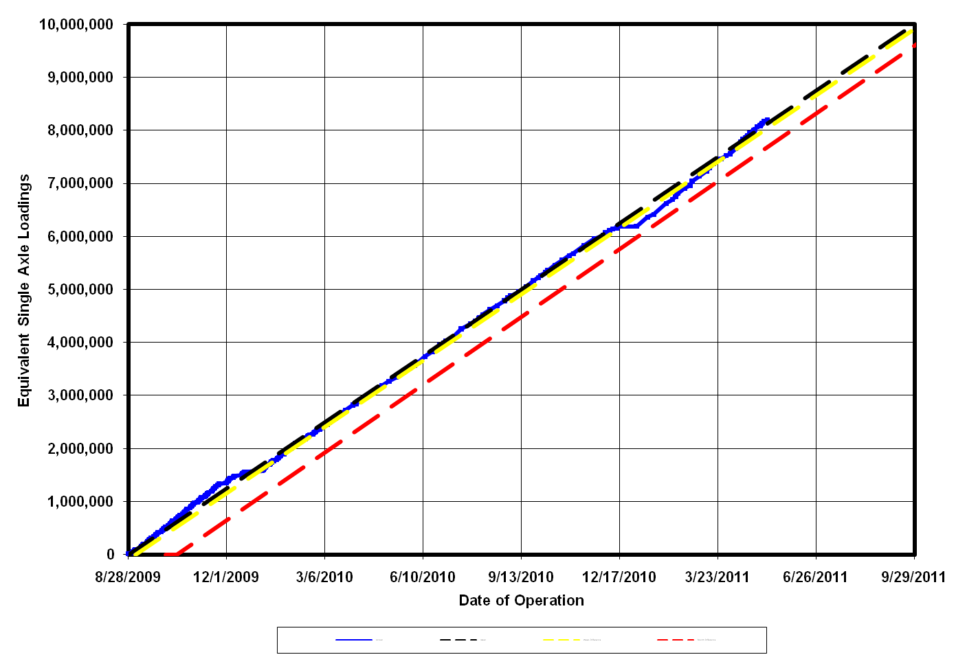
Trucking Operations

Slide 6
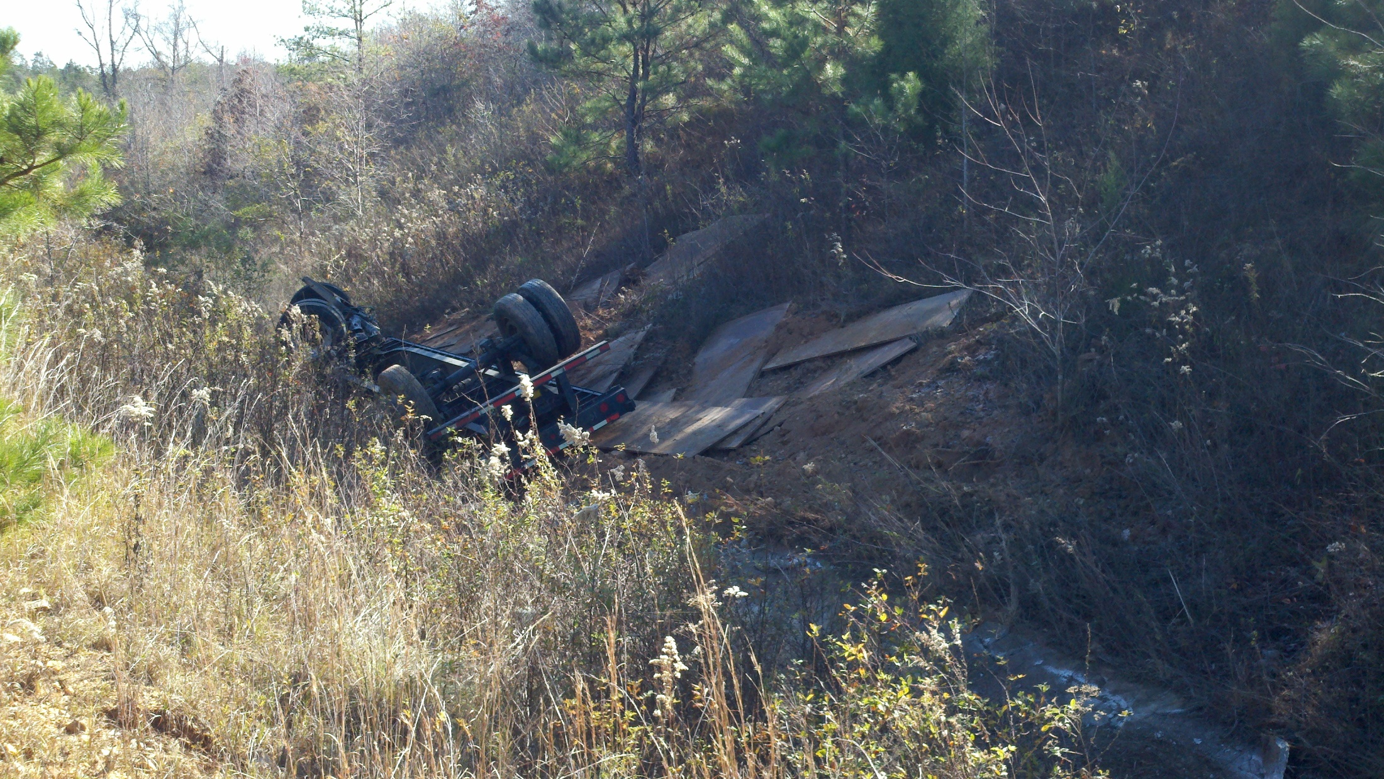
Trucking Operations_{12/6/2010}

Slide 7
Field Performance Update

Slide 8
PFC Surface Cracks (Tack Method)
2006 crack susceptible dense Superpave mix
  Surface cracks after 1.9M ESALs (Rehab at 5.6M)
2009 PFC surface placed with conventional tack
  Surface cracks after 2.2M (cracking/pumping at 8.2M)
2009 bonded PFC surface placed with spray paver
  Surface cracks after 4.1M (looks pretty good at 8.2M)

Slide 9
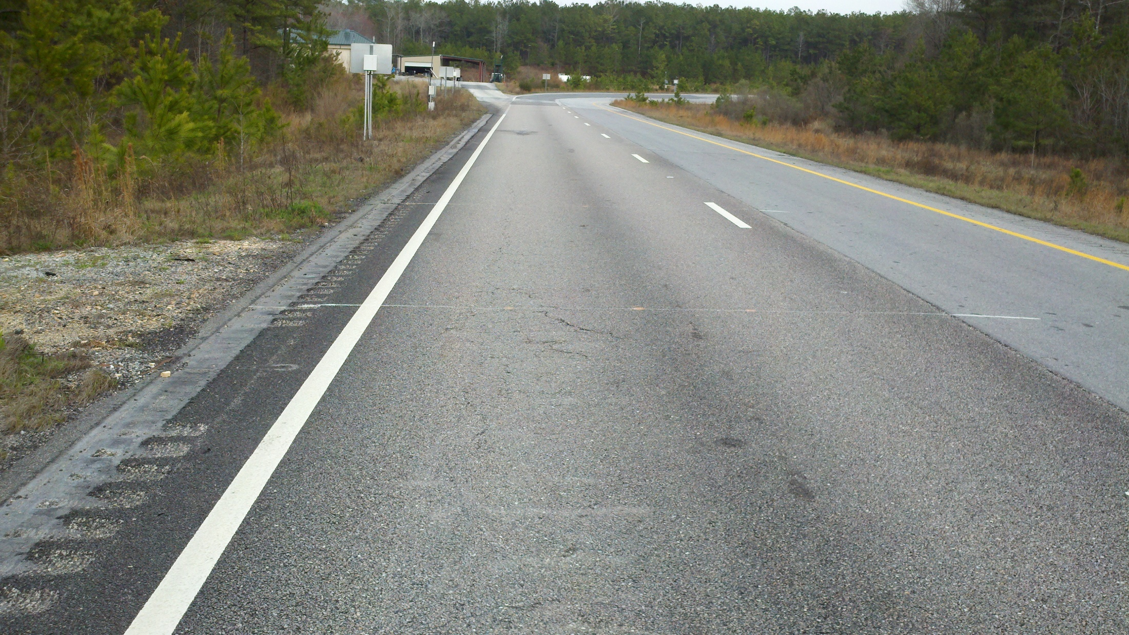
Cracking in Conventional Tack PFC

Slide 10
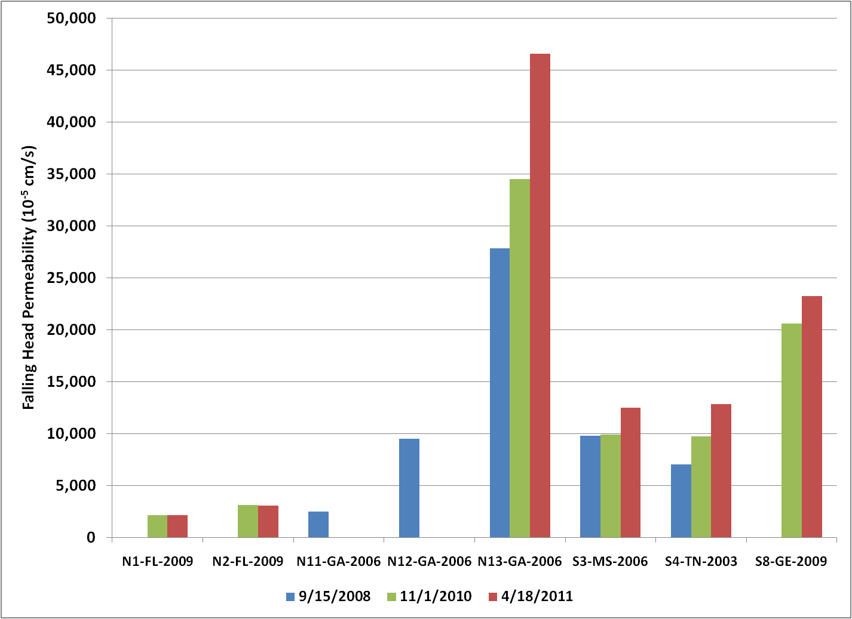
Same Mix Drains Better at 1¼”
S8 - 1¼”
Tacked
N1 - ¾”
Bonded
N2 - ¾”
Tacked

Slide 11
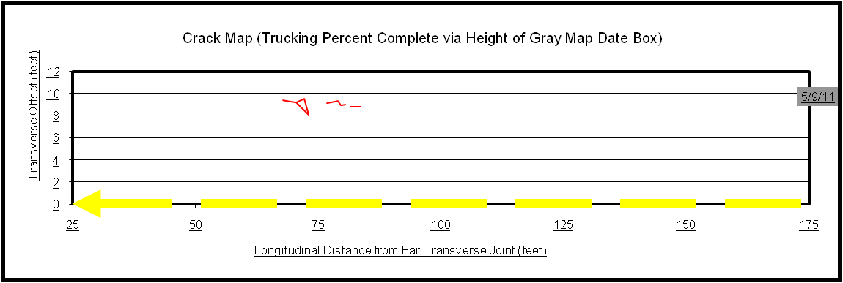
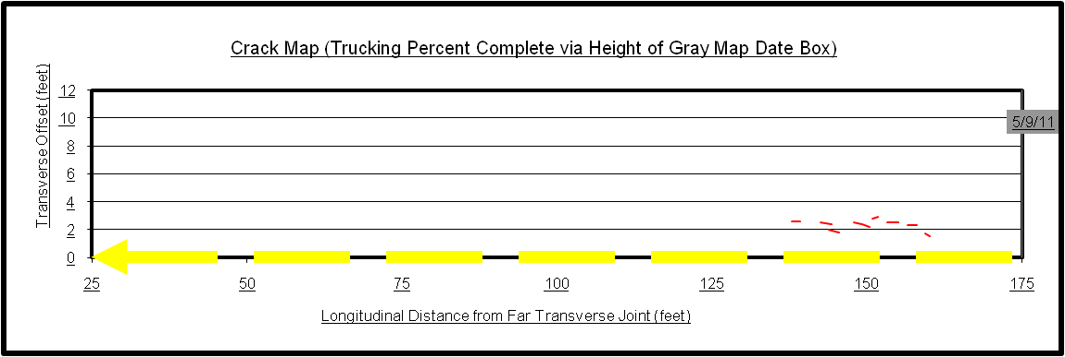
Thin Perpetual Pavements (N3/N4)

Slide 12
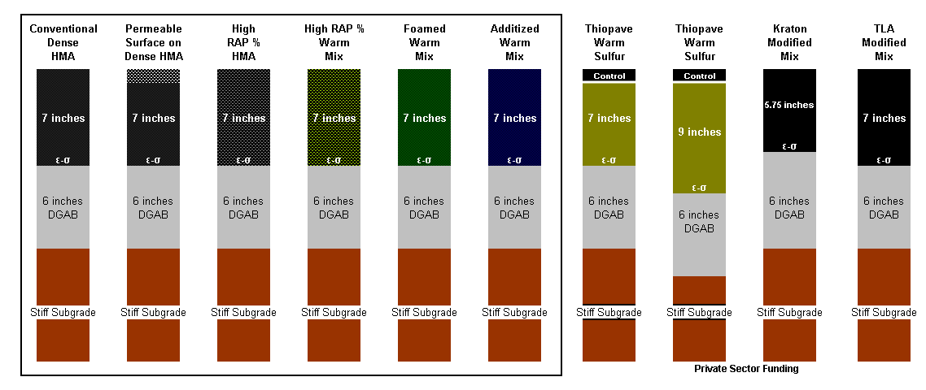
2009 Group Experiment (+)

Slide 13
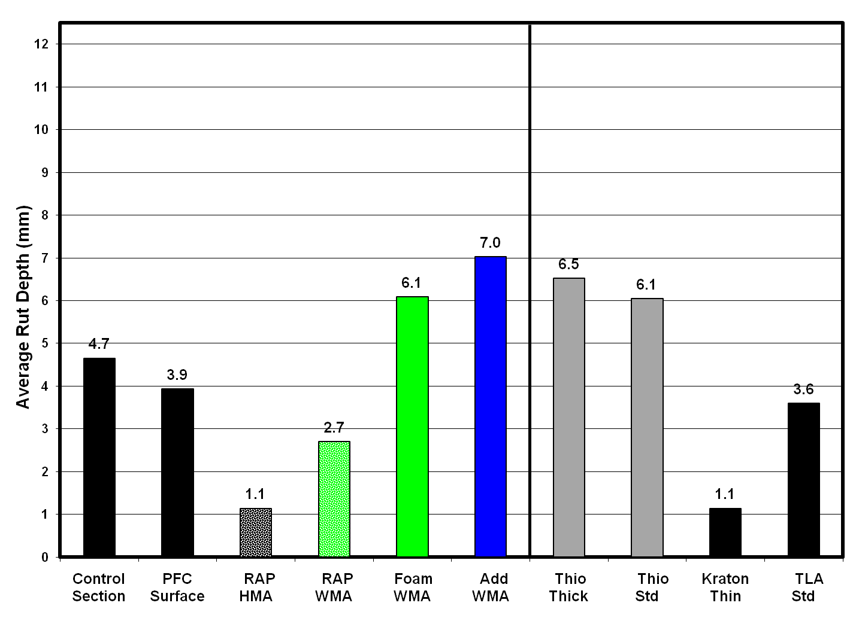
2009 Group Experiment (+)

Slide 14
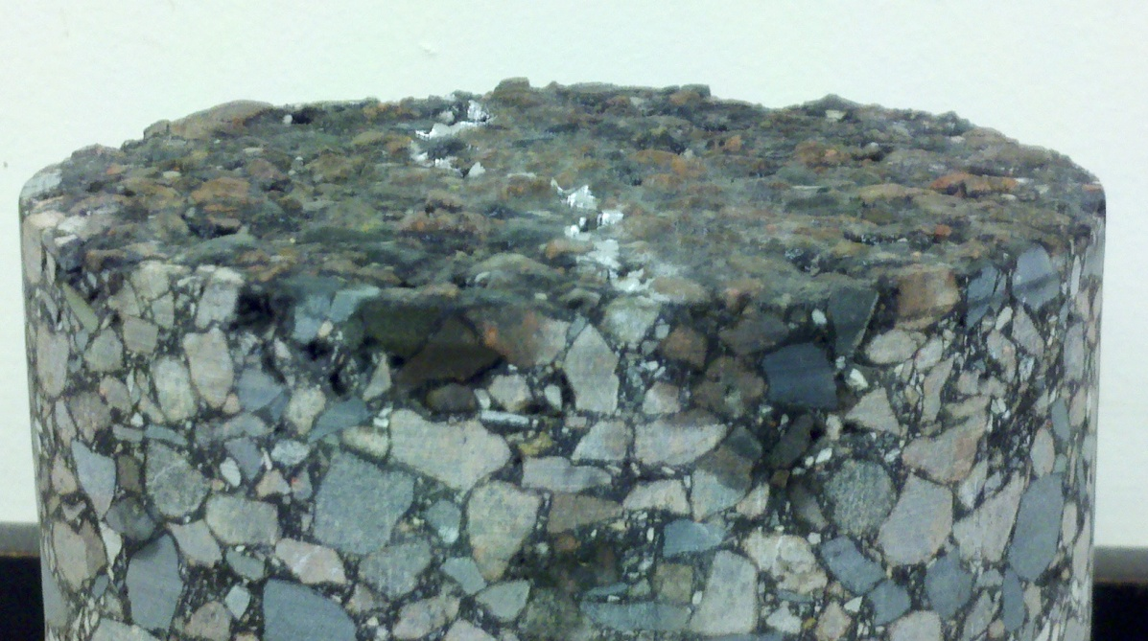
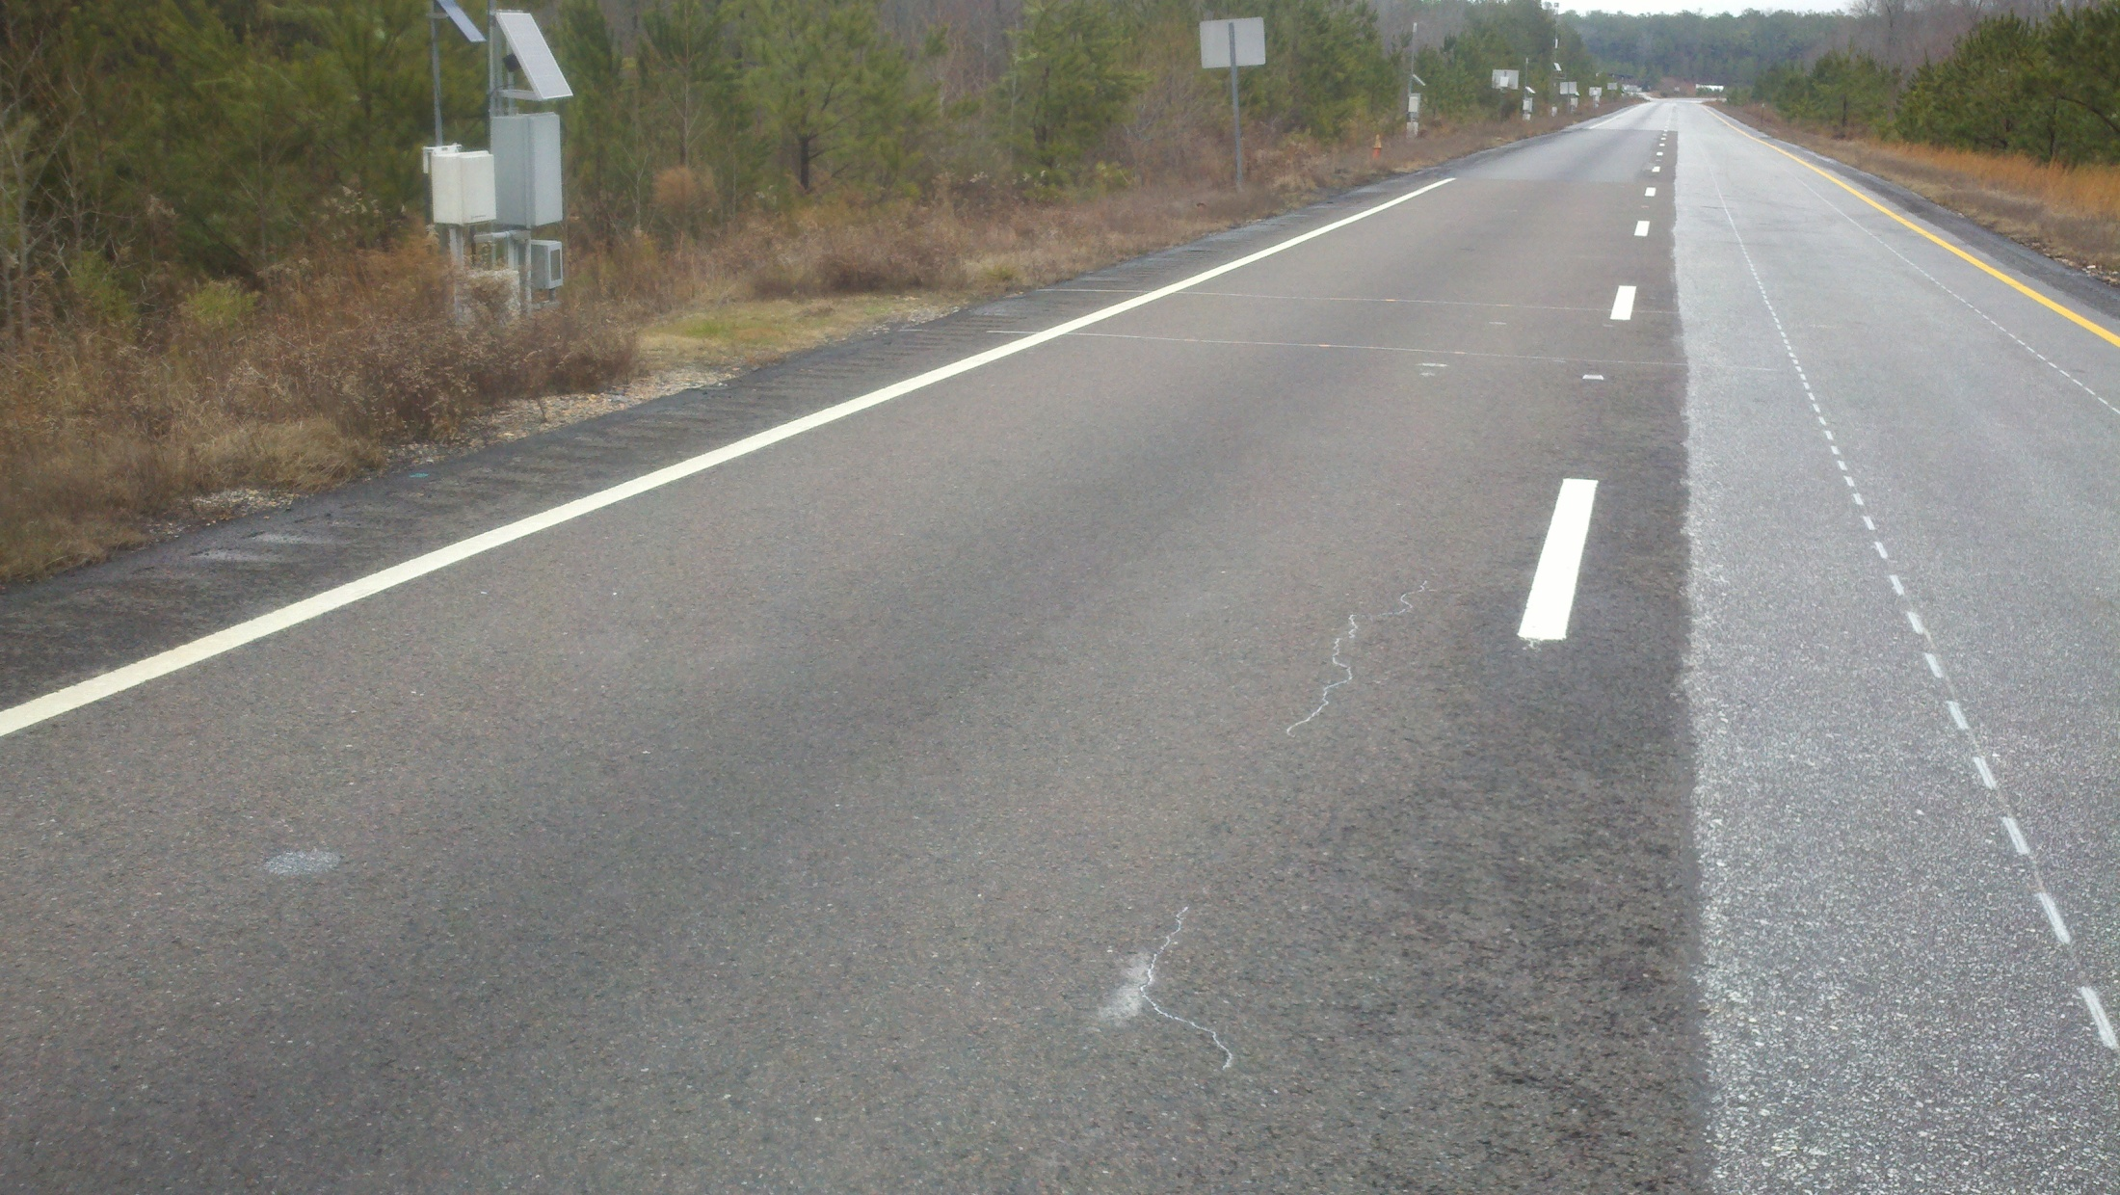
Perpetual Pavement on Soft Clay

Slide 15
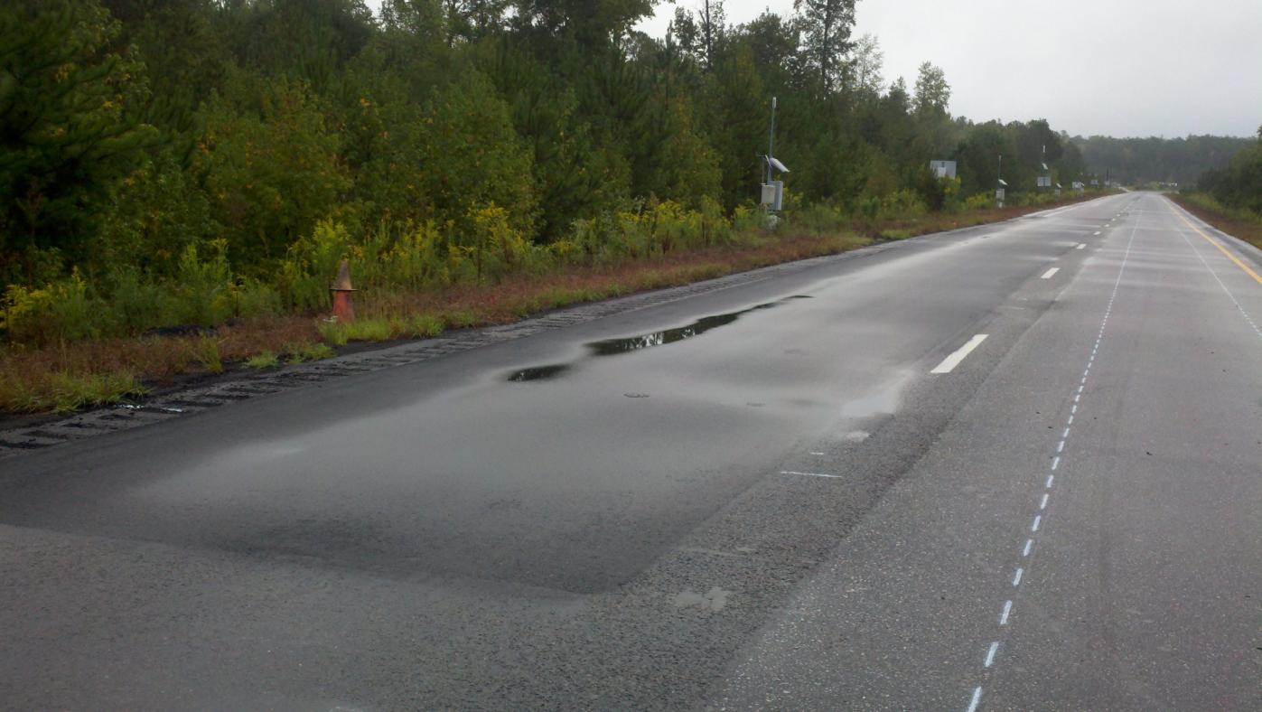
High Polymer Inlay Still Looks Good_{3.6M ESALs}

Slide 16
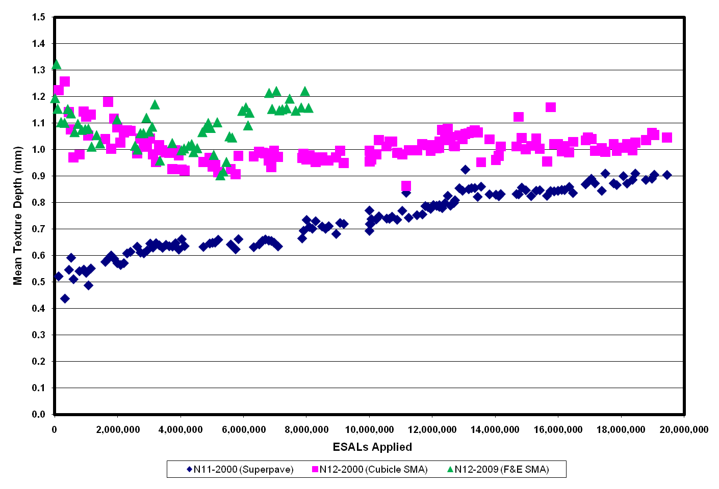
N12 SMA with High F&E Aggregates

Slide 17
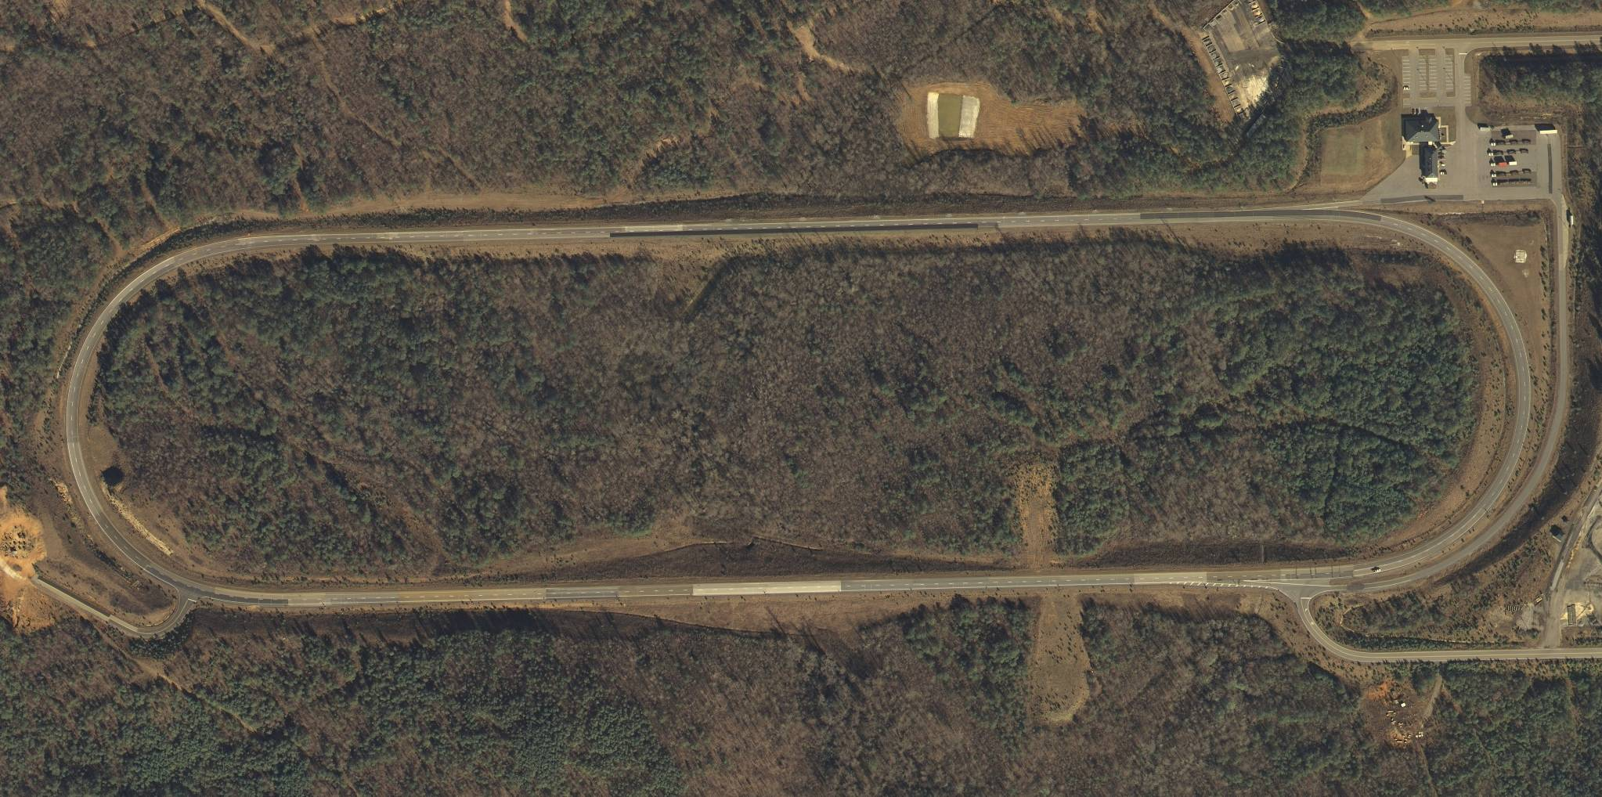
Location of High RAP Test Sections
W3-20-76
E7-45-76s
W4-20-67
E6-45-76
W5-45-52
E5-45-67

Slide 18
Location of High RAP Test Sections
W3-20-76
N11–50-67
N10–50-67
E7-45-76s
W4-20-67
E6-45-76
W5-45-52
E5-45-67
S2-45-67
S9-0-76

Slide 19
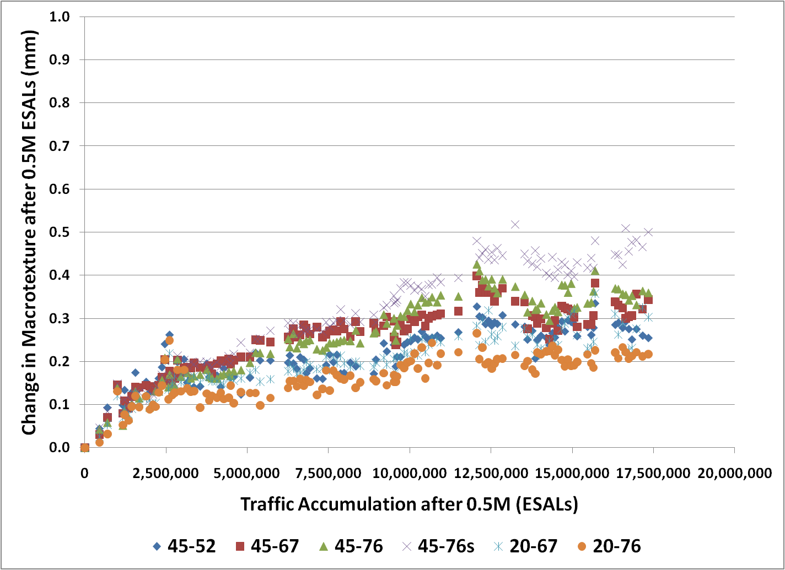
2006 High RAP Macrotexture

Slide 20
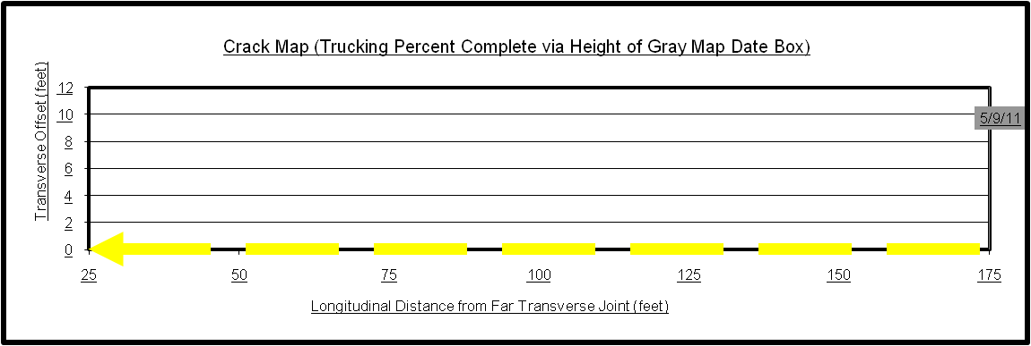
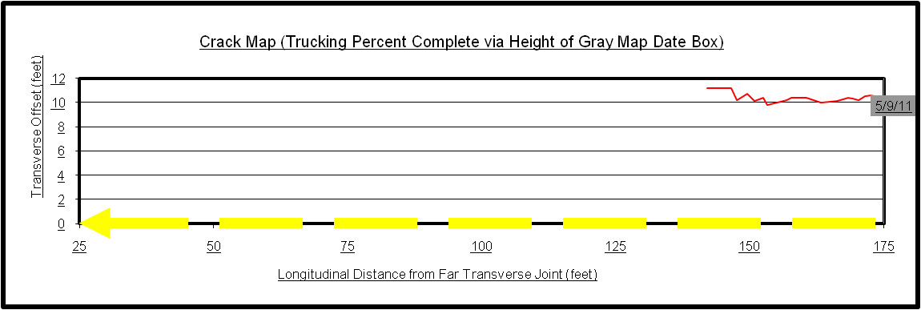
2006 High RAP Cracking

Slide 21
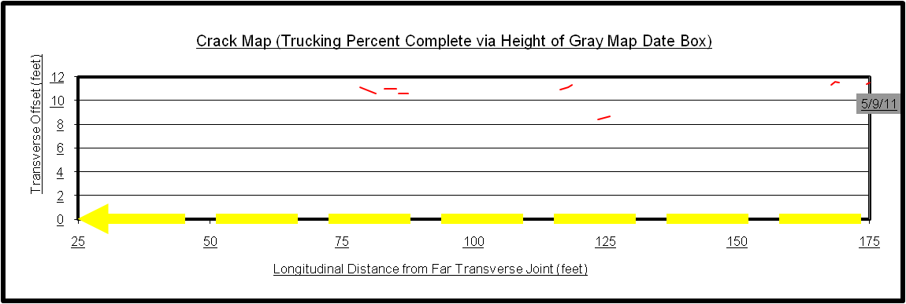
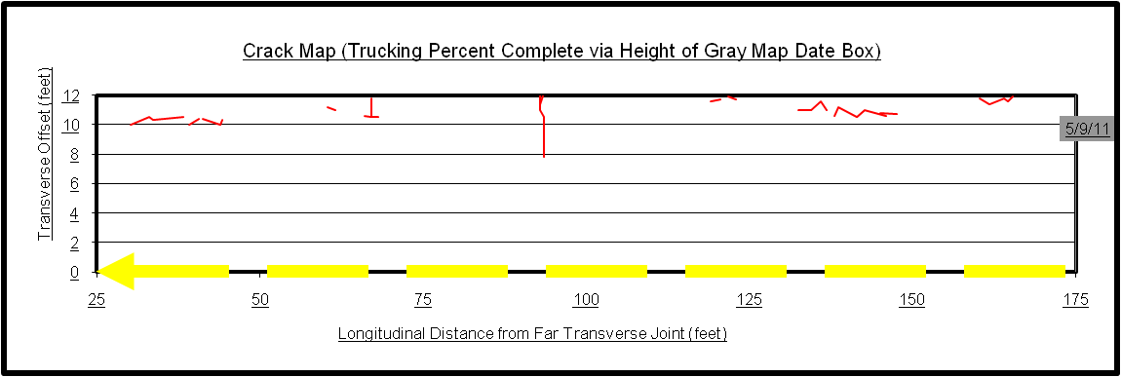
2006 High RAP Cracking

Slide 22
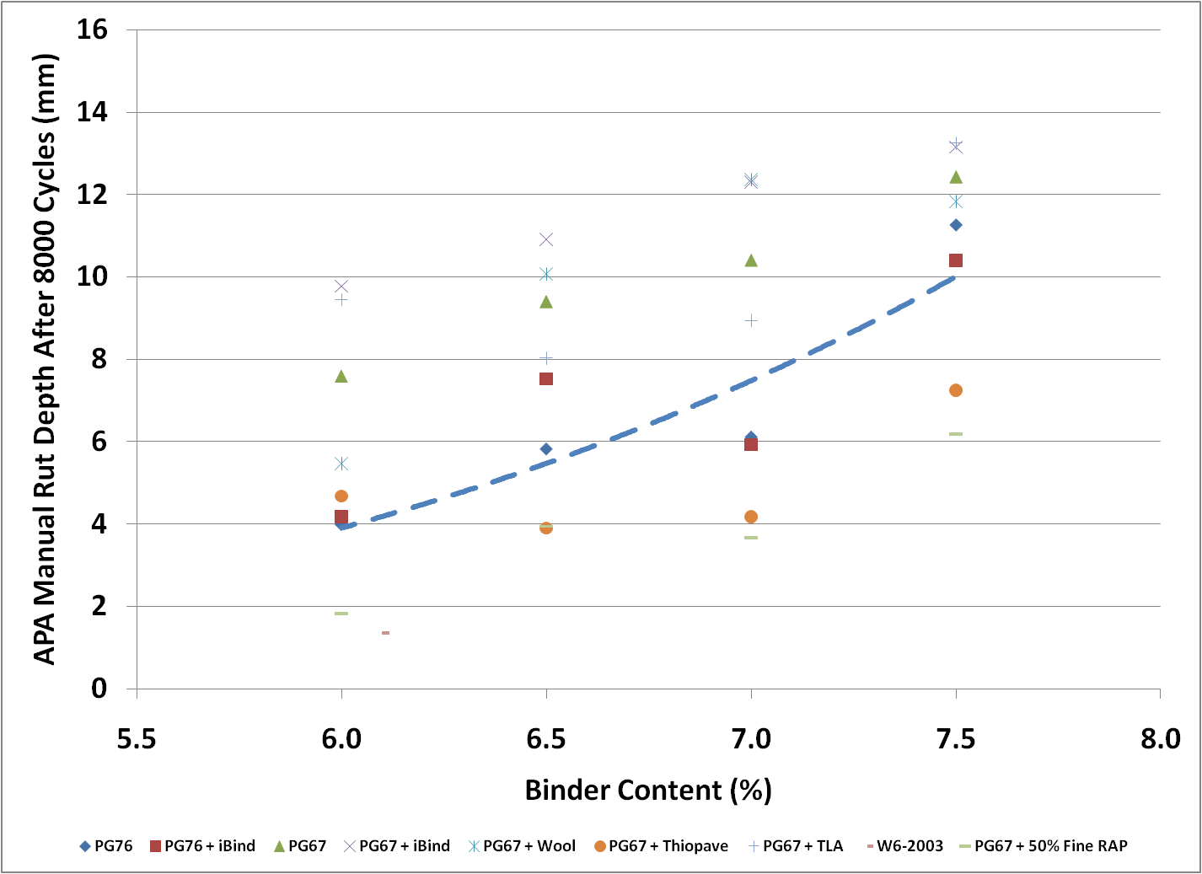
W6 Pavement Preservation 4.75 Mix

Slide 23
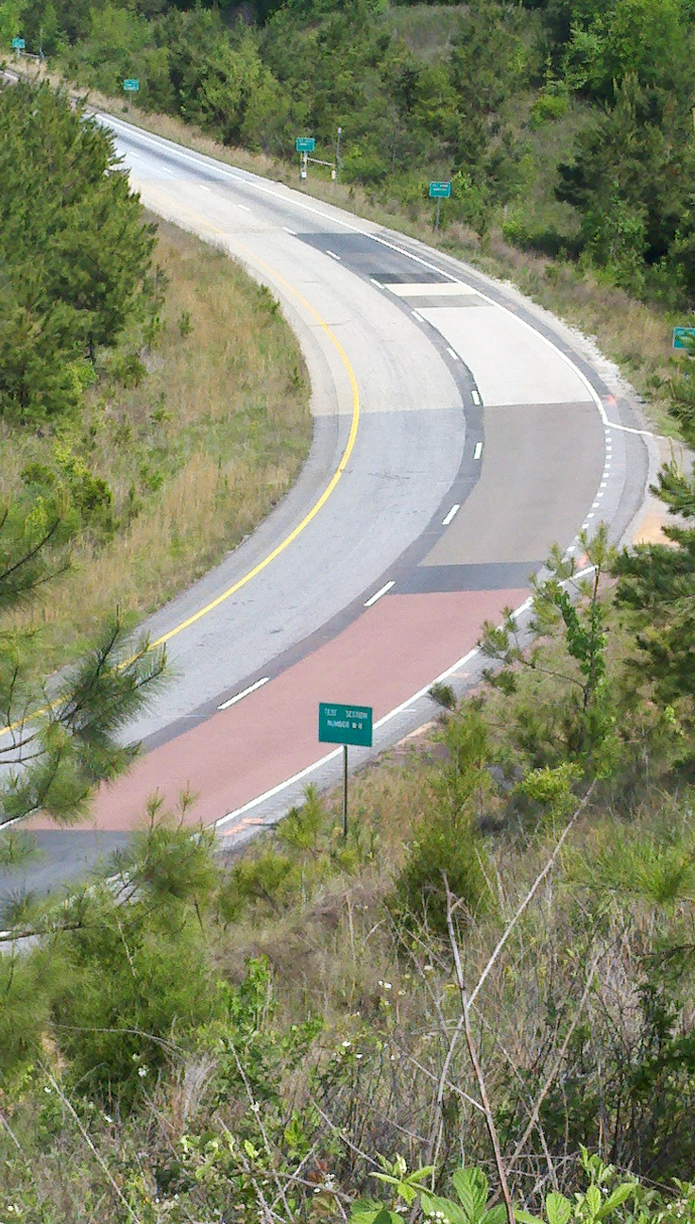
W8 & W9 High Friction Epoxy Surfaces
Taconite
Flint
Chinese bauxite
Silica
Granite
Basalt
Australian glass
Steel slag
Copper slag

Slide 24
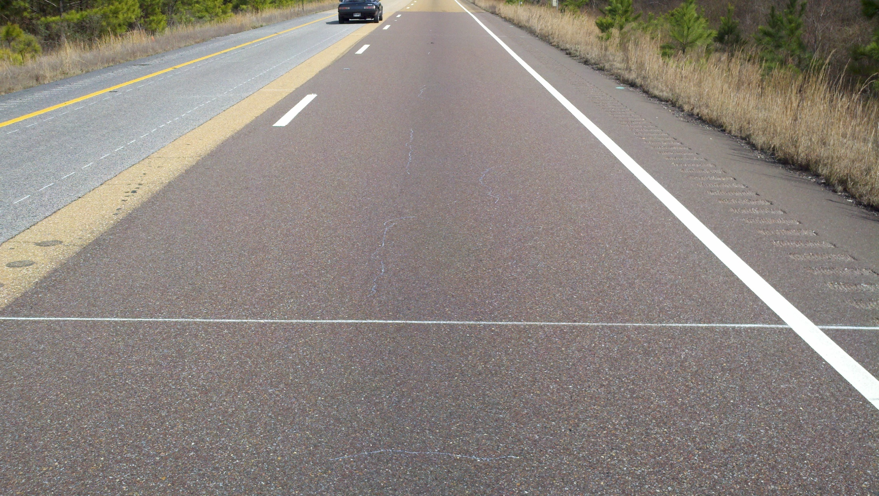
S2 High RAP Reflective Cracking

Slide 25
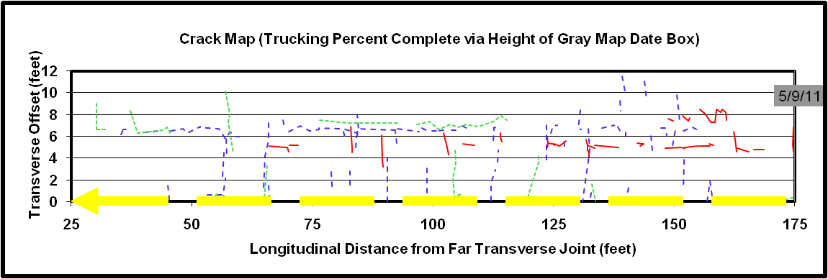
S2 High RAP Reflective Cracking

Slide 26
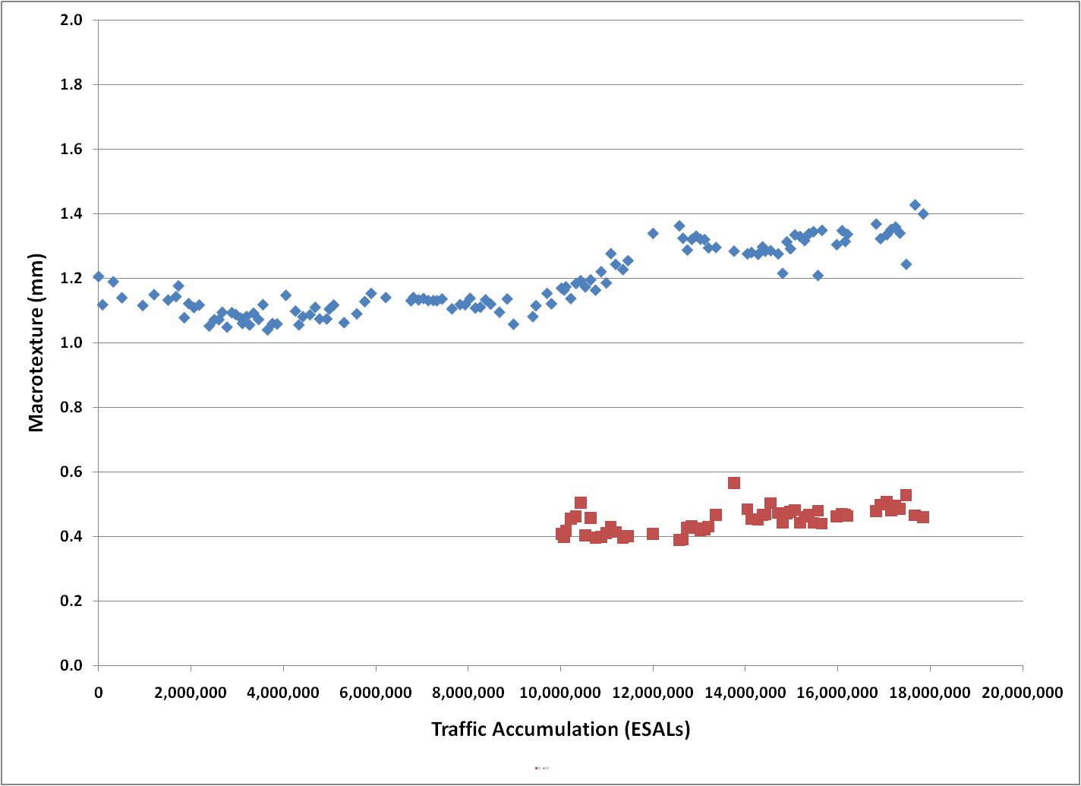
Raveling in Mississippi Mixes

Slide 27
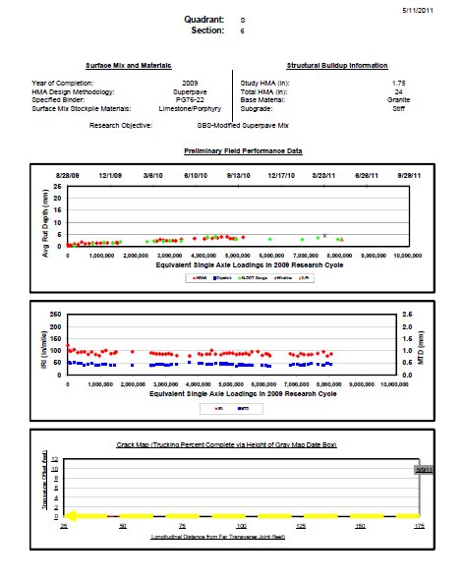
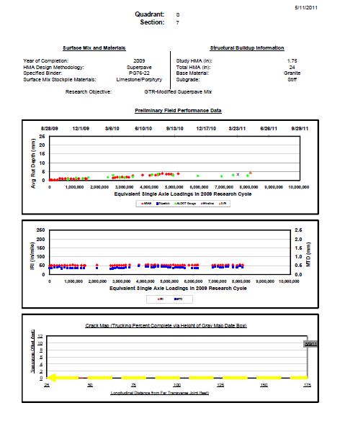
GTR vs SBS Modified Polymer Mix

Slide 28
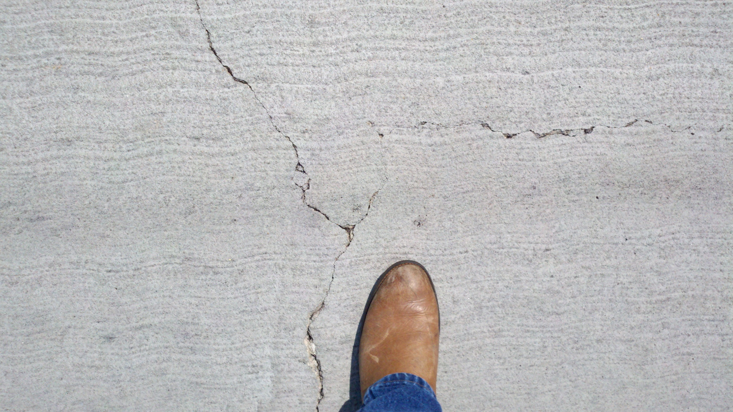
S13 Surface Treatment Cracking

Slide 29
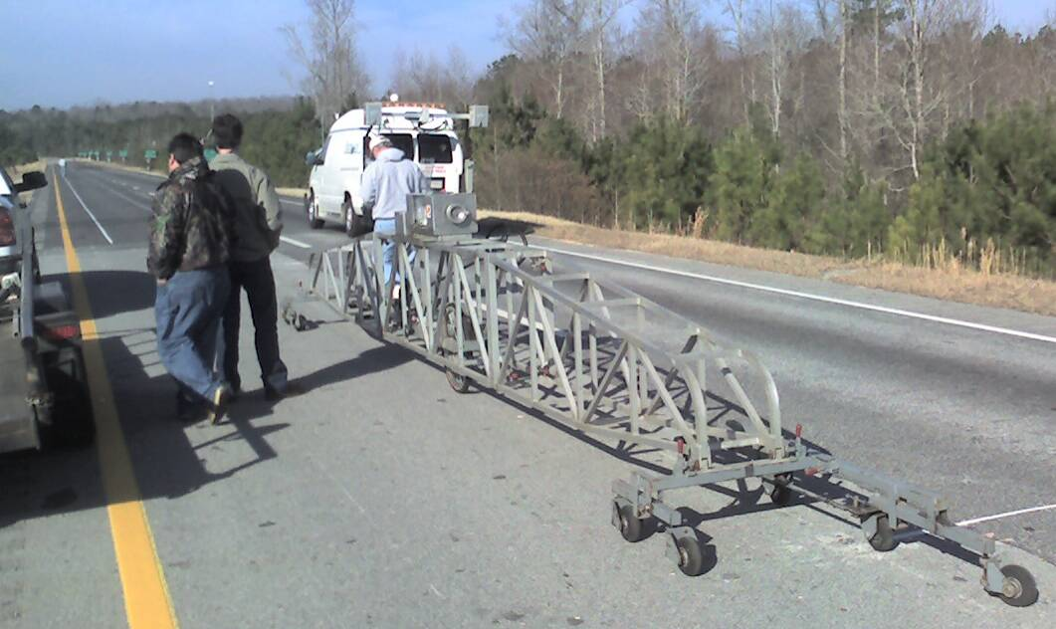
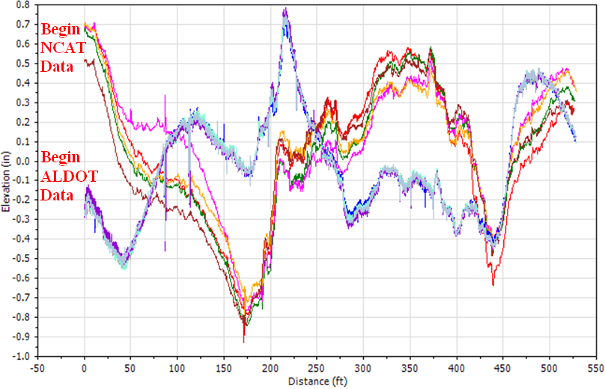
Profiler Certification Program

Slide 30
National WMA Certification Program
9.5 mm coarse granite PG67-22 mix (TSR ≈ 0.3!)
Laboratory performance of plant produced mix
  Flow number, dynamic modulus, APA
  IDT, overlay tester, bond strength, PG grading
  TSR, stripping via boiling, Hamburg (aged & unaged)
Field performance on Pavement Test Track
  Hot-mix control, immediate traffic (1 year thereafter)
  Weekly rutting, roughness, macrotexture
  Final report within 18 months of commitment

Slide 31
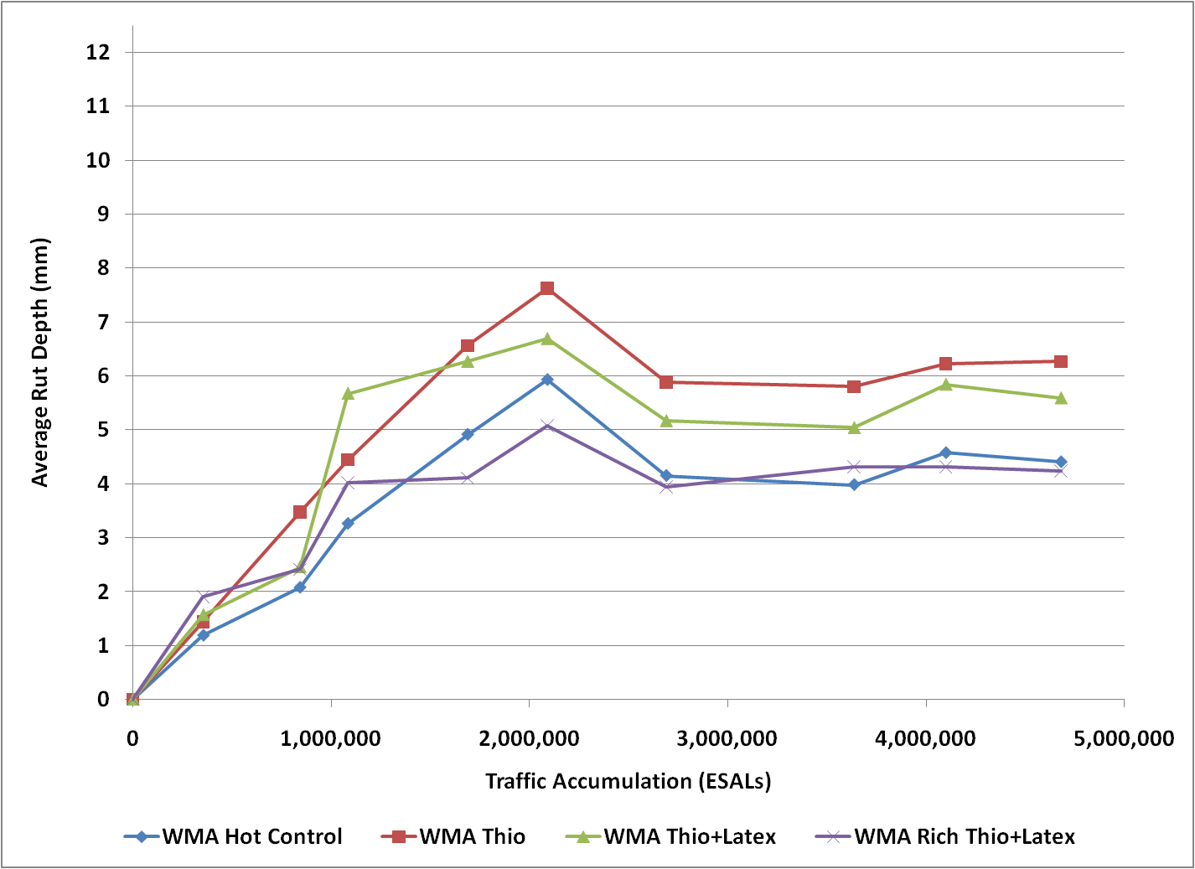
Interim WMA Field Results

Slide 32
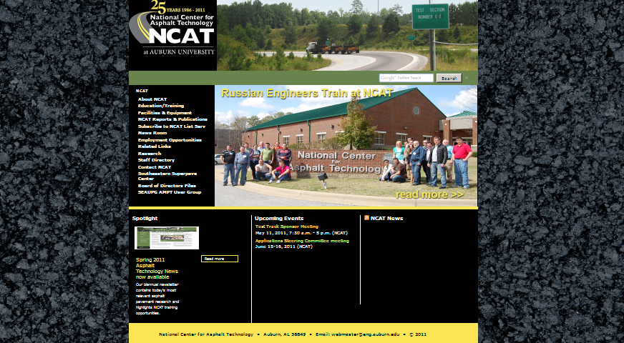
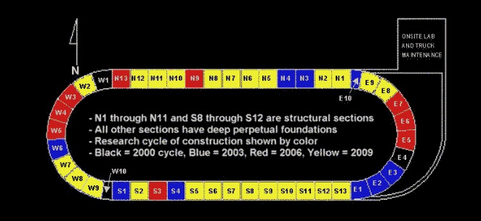
www.pavetrack.com
Home Sponsors Construction Trucking Performance Map to Track

Slide 33
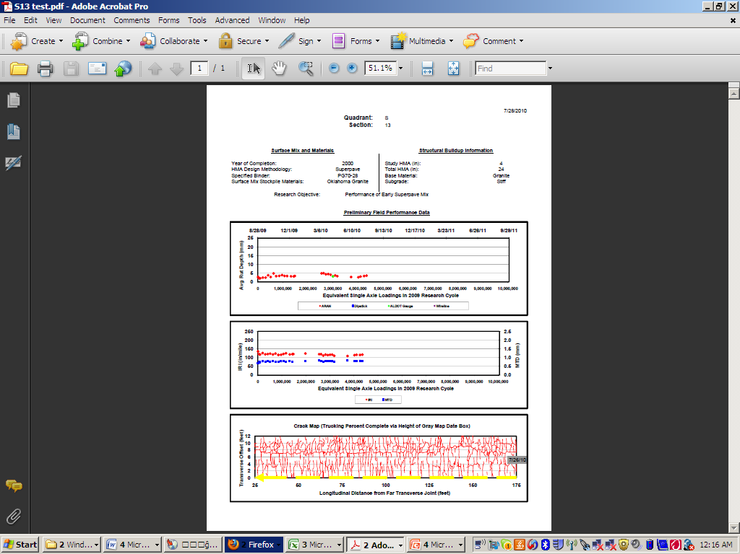
Web Performance Reports

Slide 34

Questions ?

